Slide 1
Openvswitch
Popsuper

Slide 2
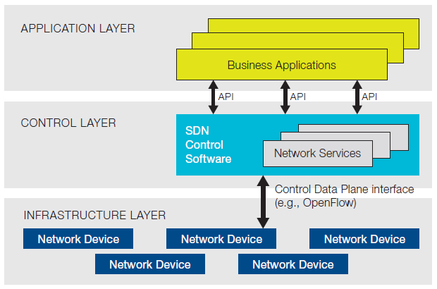


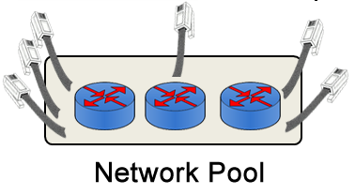
Software Defined Network
Virtual Infrastructure
CPU Pool
Storage Pool
Notes:
有了Vmware, Xen, KVM等，计算能力虚拟化了
有了LVM, Ceph, GFS等，存储能力虚拟化了
下面轮到网络了。
我们希望，网络设备仅仅起到一个联通的作用，而不需要在一个个的设备上进行复杂的配置，而是通过软件的方法，让网络管理员集中，统一的配置和管理。
SDN分三层，controller层接收上面application层发送来的配置请求，通过Openflow协议，来配置各个Network Device，当然要求这些设备需要支持Openflow协议

Slide 3
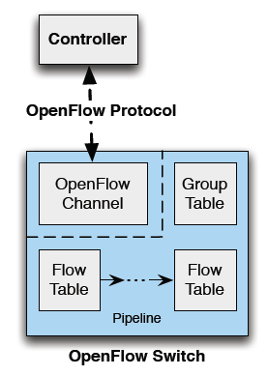
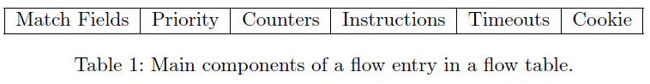
OpenFlow Switch Components
OpenFlow Channel负责同Controller的交互
Flow Table包含许多entry，每个entry是对packet进行处理的规则
Group Table：处理更复杂的转发规则
包含一系列Group Entry
每个Entry包含一系列操作集合(action buckets)
每个操作集合包含一系列action，以及参数
Match packets:
ingress port
Headers
metadata
Flow entries match packets in priority order
对packet处理:
转发
修改
交给Group Table
交给下个Table
Notes:
Each flow table entry contains:
match fields: to match against packets. These consist of the ingress port and packet headers, and optionally metadata specified by a previous table.
priority: matching precedence of the flow entry.
counters: updated when packets are matched.
instructions: to modify the action set or pipeline processing.
timeouts: maximum amount of time or idle time before flow is expired by the switch.
cookie: opaque data value chosen by the controller. May be used by the controller to filter flow statistics, flow modification and flow deletion. Not used when processing packets.
Instructions associated with each flow entry either contain actions or modify pipeline processing
Actions describe packet forwarding, packet modi cation and group table processing.
Pipeline processing instructions allow packets to be sent to subsequent tables for further processing and allow metadata to be communicated between tables.

Slide 4
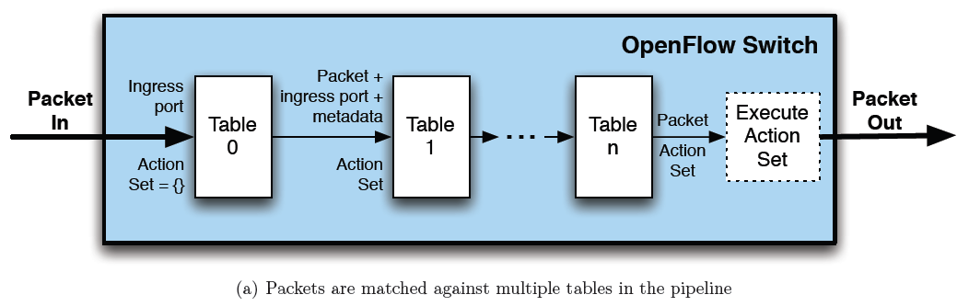
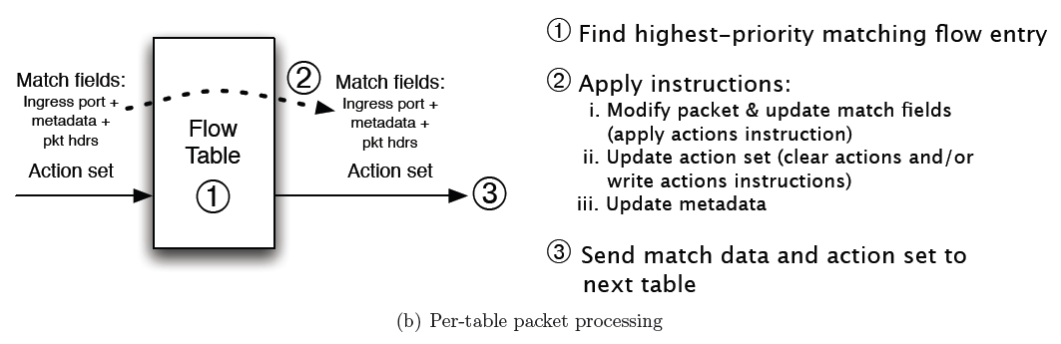
OpenFlow Packet Processing

Slide 5
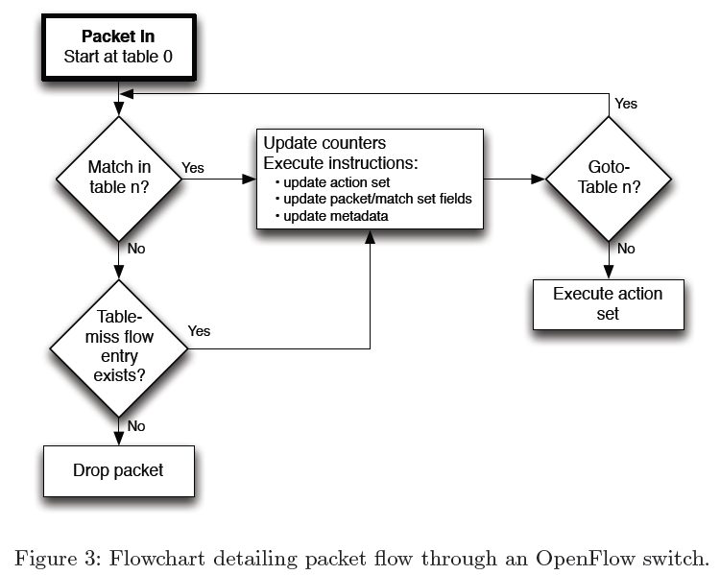
OpenFlow Packet Processing
Actions:
Output: 转发
Set-Queue: QoS
Drop
Group
Push/Pop tags
Notes:
Actions:
Output. The Output action forwards a packet to a speci ed OpenFlow port
Set-Queue. The set-queue action sets the queue id for a packet. When the packet is forwarded to a port using the output action, the queue id determines which queue attached to this port is used for scheduling and forwarding the packet.
Drop. There is no explicit action to represent drops.
Group. Process the packet through the specified group.
Push-Tag/Pop-Tag. Switches may support the ability to push/pop tags

Slide 6
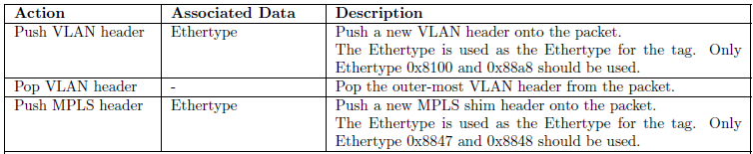
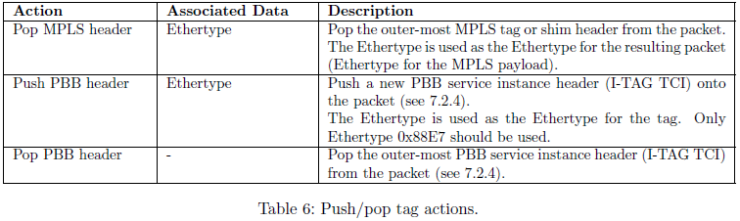
OpenFlow Packet Processing
Actions:
Output: 转发
Set-Queue: QoS
Drop
Group
Push/Pop tags

Slide 7
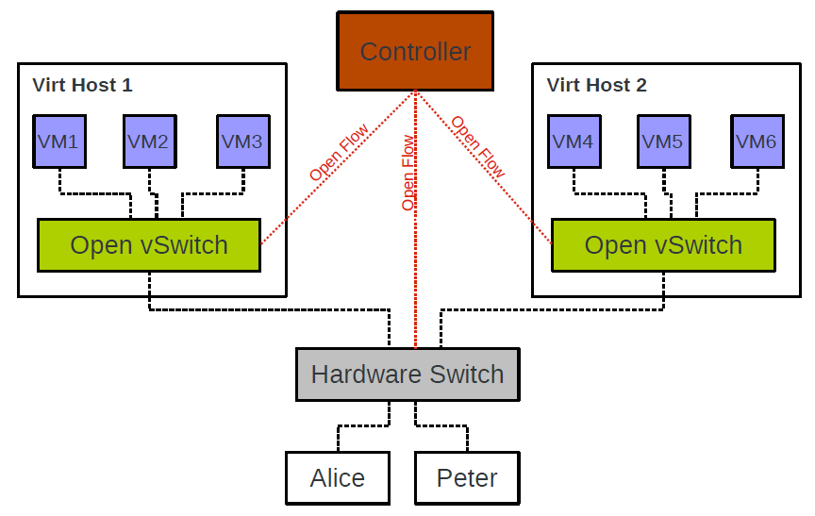
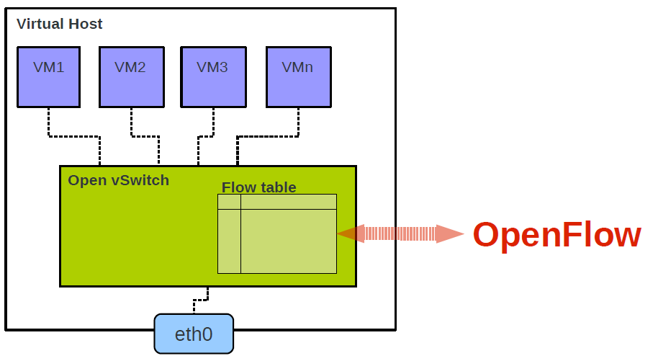
Openvswitch简介
Openvswitch是一个virutal swtich， 支持Open Flow协议，当然也有一些硬件Switch也支持Open Flow协议，他们都可以被统一的Controller管理，从而实现物理机和虚拟机的网络联通。

Slide 8
Openvswitch简介
Match Field涵盖TCP/IP协议各层：
Layer 1 – Tunnel ID, In Port, QoS priority, skb mark
Layer 2 – MAC address, VLAN ID, Ethernet type
Layer 3 – IPv4/IPv6 fields, ARP
Layer 4 – TCP/UDP, ICMP, ND
Action也主要包含下面的操作：
Output to port (port range, flood, mirror)
Discard, Resubmit to table x
Packet Mangling (Push/Pop VLAN header, TOS, ...)
Send to controller, Learn

Slide 9
Openvswitch简介
可以设置Tunnel
可以支持下列的框架来监控流量。
sFlow
NetFlow
Port Mirroring
SPAN
RSPAN
ERSPAN
支持QoS
Uses existing Traffic Control Layer
Policer (Ingress rate limiter)
HTB, HFSC (Egress traffic classes)
Controller (Open Flow) can select Traffic Class

Slide 10
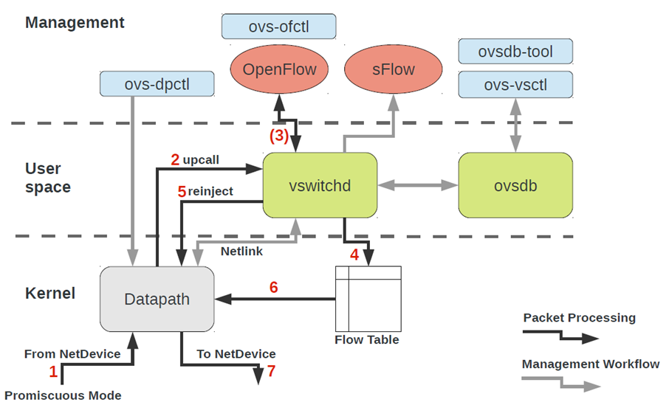
Openvswitch架构

Slide 11
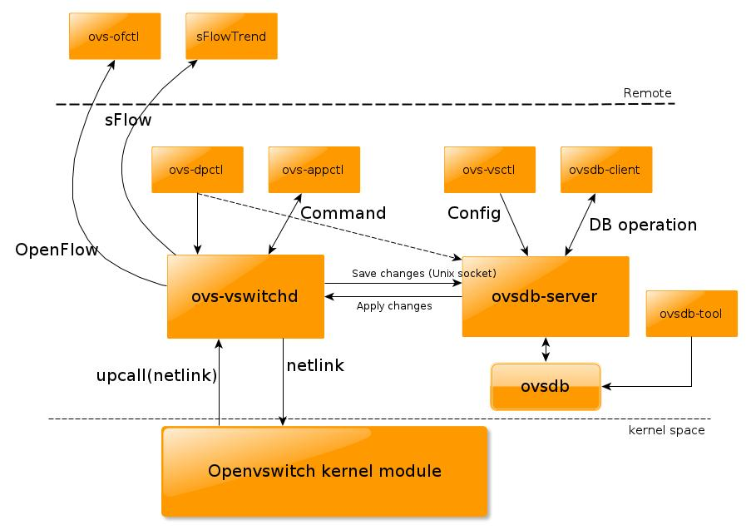
Openvswitch架构
Notes:
There are three daemons started by openvswitch service: ovs-vswitchd, which is the core implementation of the switch; ovsdb-server, which manipulates the database of the vswitch configuration and flows; and ovs-brcompatd which keeps the compatibility with the traditional bridges (that is the one you create with ‘brctl’ command) .

Slide 12
实验一：查看Openvswitch的架构
root@popsuper1982:~# ps aux | grep openvswitch
root 985 0.0 0.0 21172 2120 ? S< Aug06 1:20 ovsdb-server /etc/openvswitch/conf.db -vconsole:emer -vsyslog:err -vfile:info --remote=punix:/var/run/openvswitch/db.sock --private-key=db:Open_vSwitch,SSL,private_key --certificate=db:Open_vSwitch,SSL,certificate --bootstrap-ca-cert=db:Open_vSwitch,SSL,ca_cert --no-chdir --log-file=/var/log/openvswitch/ovsdb-server.log --pidfile=/var/run/openvswitch/ovsdb-server.pid --detach --monitor
root 1008 0.1 0.8 242948 31712 ? S<Ll Aug06 32:17 ovs-vswitchd unix:/var/run/openvswitch/db.sock -vconsole:emer -vsyslog:err -vfile:info --mlockall --no-chdir --log-file=/var/log/openvswitch/ovs-vswitchd.log --pidfile=/var/run/openvswitch/ovs-vswitchd.pid --detach --monitor
root@popsuper1982:~# lsmod | grep openvswitch
openvswitch 66901 0
gre 13808 1 openvswitch
vxlan 37619 1 openvswitch
libcrc32c 12644 2 btrfs,openvswitch

Slide 13
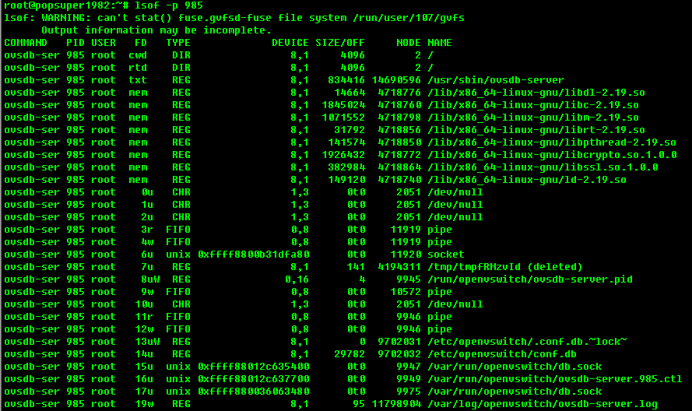
实验一：查看Openvswitch的架构

Slide 14
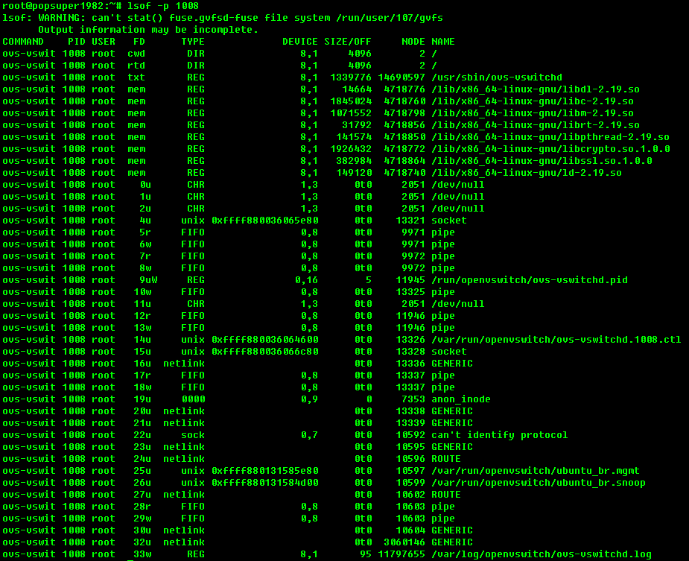
实验一：查看Openvswitch的架构

Slide 15
实验一：查看Openvswitch的架构
strace ovs-vsctl show
//建立unix socket，和ovs-dbserver进行通信
socket(PF_LOCAL, SOCK_STREAM, 0) = 3
fcntl(3, F_GETFL) = 0x2 (flags O_RDWR)
fcntl(3, F_SETFL, O_RDWR|O_NONBLOCK) = 0
connect(3, {sa_family=AF_LOCAL, sun_path="/var/run/openvswitch/db.sock"}, 31) = 0
//写入命令
write(3, "{\"method\":\"monitor\",\"id\":0,\"para"..., 409) = 409
//读取结果
read(3, "{\"id\":0,\"result\":{\"Port\":{\"8afee"..., 512) = 512
read(3, "7a8\"],[\"uuid\",\"8afee51e-6e71-4d4"..., 512) = 501
read(3, 0x24b4d05, 11) = -1 EAGAIN (Resource temporarily unavailable)
向终端输出结果
write(1, "c1fe4192-ae6a-457f-a2e1-dfc67284"..., 37c1fe4192-ae6a-457f-a2e1-dfc6728470eb) = 37
write(1, " Bridge ubuntu_br\n", 21 Bridge ubuntu_br) = 21
write(1, " Port ubuntu_br\n", 23 Port ubuntu_br) = 23
write(1, " Interface ubuntu_br\n", 32 Interface ubuntu_br) = 32
write(1, " type: internal\n", 31 type: internal) = 31
write(1, " Port \"vnet0\"\n", 21 Port "vnet0") = 21
write(1, " Interface \"vnet0\"\n", 30 Interface "vnet0") = 30
write(1, " ovs_version: \"2.0.1\"\n", 25 ovs_version: "2.0.1") = 25

Slide 16
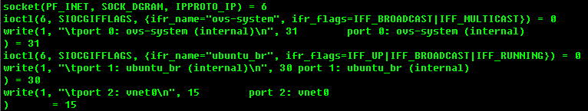
实验一：查看Openvswitch的架构
strace ovs-dpctl show

Slide 17
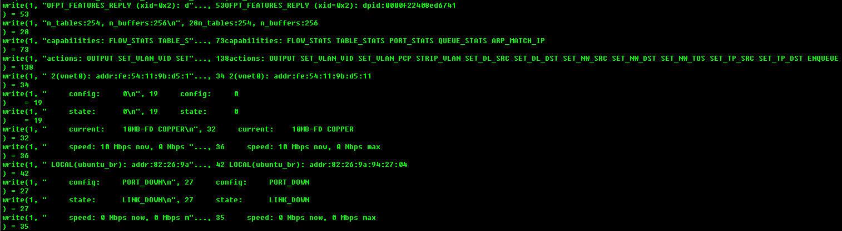
实验一：查看Openvswitch的架构
# strace ovs-ofctl show ubuntu_br
socket(PF_LOCAL, SOCK_STREAM, 0) = 3
connect(3, {sa_family=AF_LOCAL, sun_path="/var/run/openvswitch/ubuntu_br"}, 33) = -1 ENOENT (No such file or directory)
close(3) = 0
socket(PF_LOCAL, SOCK_STREAM, 0) = 3
connect(3, {sa_family=AF_LOCAL, sun_path="/var/run/openvswitch/ubuntu_br.mgmt"}, 38) = 0

Slide 18
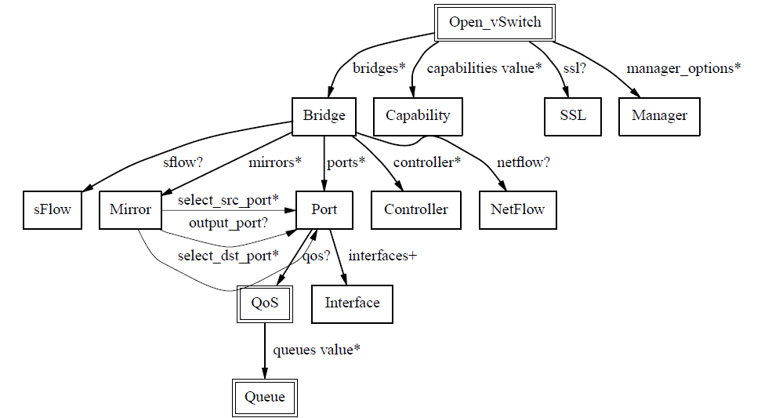
Openvswitch数据库表结构

Slide 19
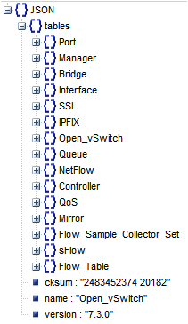
实验二：打印数据库表结构
cat /etc/openvswitch/conf.db，我们会发现它是json格式的
数据库可以通过ovsdb-client dump将数据库内容打印出来

Slide 20
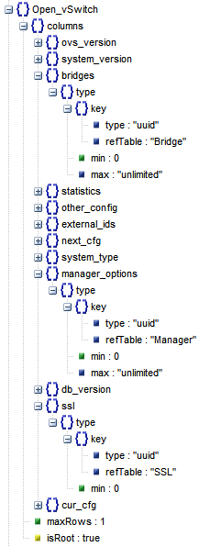
Openvswitch: Open_vSwitch表
数据库的根
全局的配置项
other_config : stats-update-interval ：将统计信息写入数据库的间隔时间
other_config : flow-limit ：在flow table中flow entry的数量
other_config : n-handler-threads ：用于处理新flow的线程数
other_config : n-revalidator-threads ：用于验证flow的线程数.
other_config : enable-statistics 是否统计
statistics : cpu 统计cpu数量，线程
statistics : load_average system load
statistics : memory 总RAM，swap
statistics : process_NAME ：with NAME replaced by a process name，统计memory size, cpu time等
statistics : file_systems：mount point, size, used
指向其他表
bridge表
SSL表
Manager表

Slide 21
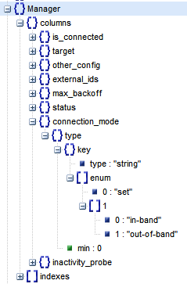
Openvswitch: Manager
Manager表配置的是ovsdb-server的
ovsdb-server使用manager_options中的配置来监听端口，等待client来连接。
punix:file: 监听unix socket
ptcp:port[:ip]: 监听TCP连接
pssl:port[:ip]: 监听SSL连接

Slide 22
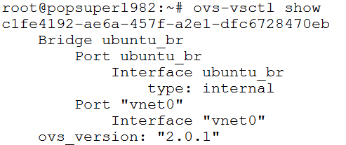
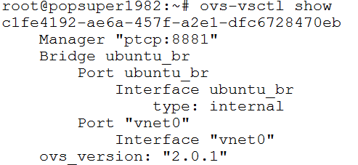
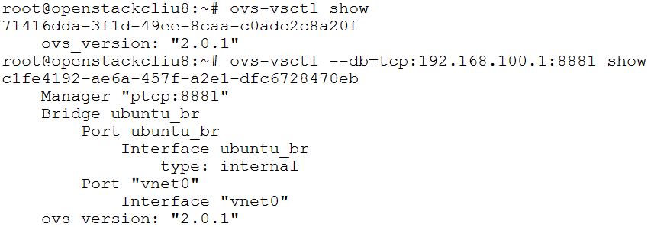
实验三：设置Manager的TCP连接
ovs-vsctl set-manager ptcp:8881
在另外一台机器上

Slide 23
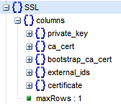
Openvswitch: SSL
SSL的配置主要包含几个部分：
Private Key: 私钥
Certificate: 证书
CA Certificate: CA的证书
private key和public key对，其中public key放在certificate中，并且需要CA使用自己的private key进行签名，CA来担保这个certificate是合法的，为了验证这个CA签名，当然需要CA的public key，而CA的public key是放在ca cert里面的，当然也需要被签名，被更高级的CA担保，或者自己担保自己。
bootstrap_ca_cert是一个boolean，如果是true，则每次启动的时候，都会向controller去拿最新的ca cert。
默认表是空的

Slide 24
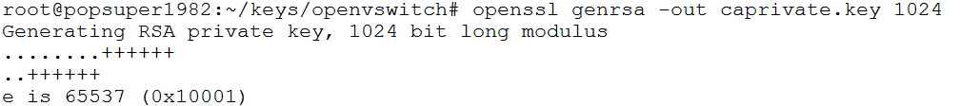
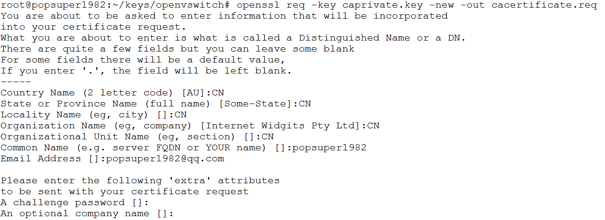
实验四：设置SSL连接
生成private key, certificate, CA key, CA certificate
生成一个CA的private key
CA有一个certificate，里面放着CA的public key，要生成这个certificate，则需要写一个certificate request
openssl genrsa -out caprivate.key 1024
openssl req -key caprivate.key -new -out cacertificate.req

Slide 25
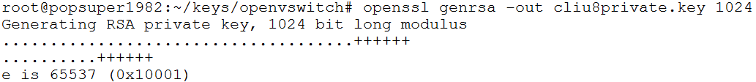
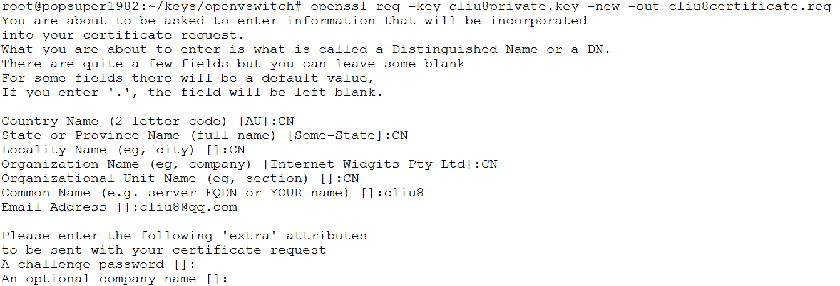
实验四：设置SSL连接
3. 由于这里的CA是root CA，没有更高级的CA了，所以要进行自签发，用自己的private key对自己的certificate请求进行签发
4. 普通的机构需要有自己的private key
5. 也需要一个证书，里面放自己的public key，需要一个证书请求
openssl x509 -req -in cacertificate.req -signkey caprivate.key -out cacertificate.pem
openssl genrsa -out cliu8private.key 1024
openssl req -key cliu8private.key -new -out cliu8certificate.req

Slide 26
实验四：设置SSL连接
6. 要使得这个证书被认可，则需要一个CA对这个证书进行签名，我们用上面的CA的private key对他进行签名
openssl x509 -req -in cliu8certificate.req -CA cacertificate.pem -CAkey caprivate.key -out cliu8certificate.pem -CAcreateserial

Slide 27
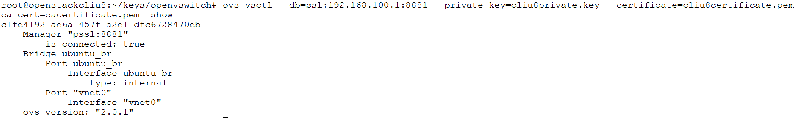
实验四：设置SSL连接
设置manager
在另一台机器上
ovs-vsctl del-manager
ovs-vsctl set-manager pssl:8881
ovs-vsctl set-ssl /root/keys/openvswitch/cliu8private.key /root/keys/openvswitch/cliu8certificate.pem /root/keys/openvswitch/cacertificate.pem

Slide 28
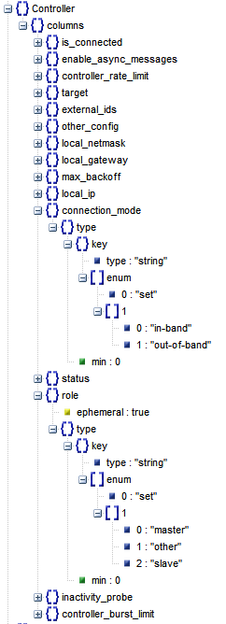
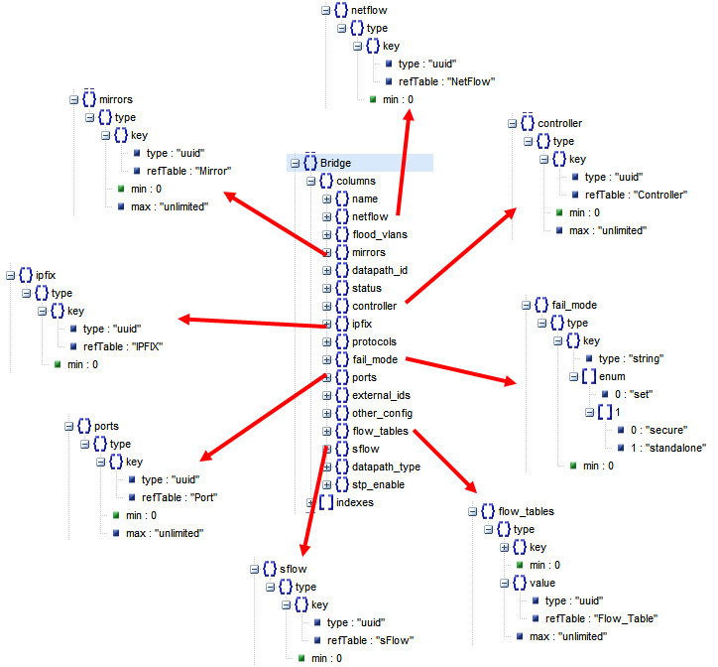
Openvswitch: Controller

Slide 29
Openvswitch: Controller
OpenFlow配置项：从架构图中我们可以看出，openvwitch的一个bridge可以通过openflow协议，被一个统一的controller管理的
Controller
flow_tables
fail_mode:
一旦一个bridge连到一个openflow controller，则flow table就由controller统一管理，如果连接断了
secure： 这个bridge会试图一直连接controller，并不自己建立flow table
standalone：一旦bridge三次连不上controller，就自己建立和管理flow table
datapath_id：

Slide 30
Openvswitch: Controller
OpenFlow Controller多种多样
http://groups.geni.net/geni/wiki/OpenFlow/Controllers
Beacon is a Java-based controller that supports both event-based and threaded operation. Beacon was developed at Stanford.
Floodlight is a Java-based controller that was forked from the Beacon controller, and now is supported by a community of developers. Floodlight is released under the Apache License.
Maestro is a multi-threaded Java-based platform that allows developers to implement new OpenFlow controllers. Maestro was developed at Rice University.
NodeFlow is an OpenFlow controller written in pure JavaScript for Node.JS. Node.JS provides an asynchronous library over JavaScript for server side programming which is perfect for writing network based applications.
NOX is a C++ based platform that gives the ability to developers to implement new controllers by writing NOX modules in either C++.
POX is a Python based platform that gives the ability to developers to implement new controllers by writing NOX modules in either Python. Pox was part of what is now called Nox classic, but it was separated into a different controller platform that only supports Python.
Trema is a C based platform that allows developers to write new controllers by writing Trema modules in either C or Ruby. Trema was developed by NEC.

Slide 31
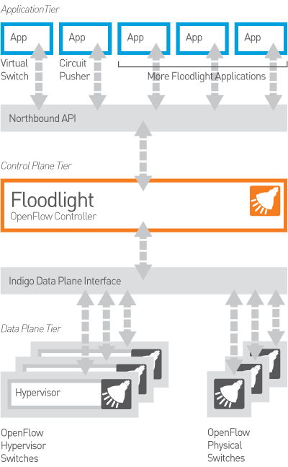
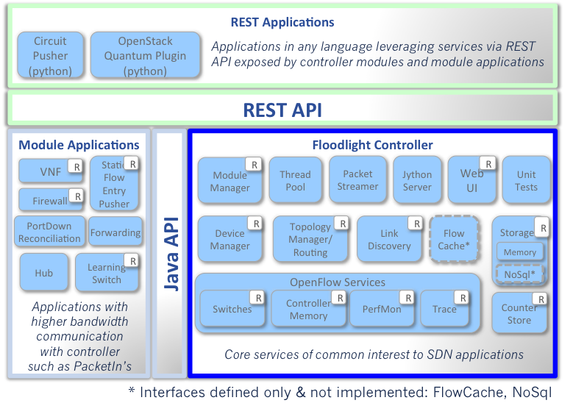
Openvswitch: Controller
使用Floodlight

Slide 32
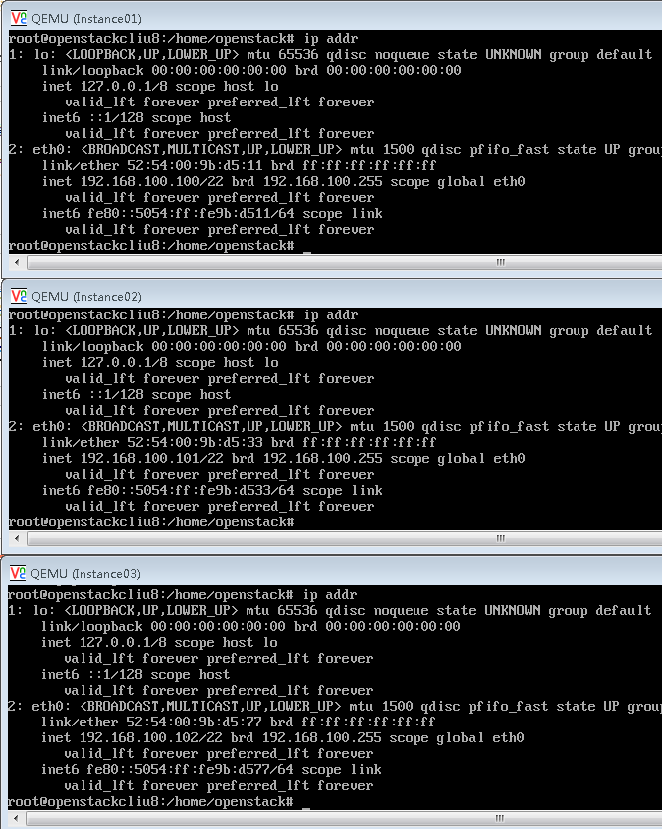
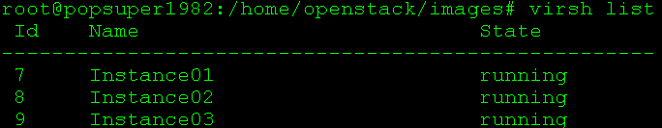
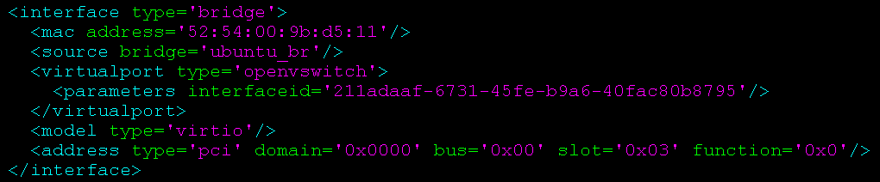
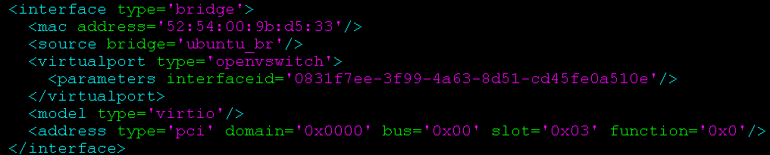

实验五：配置使用OpenFlow Controller
创建三个虚拟机

Slide 33
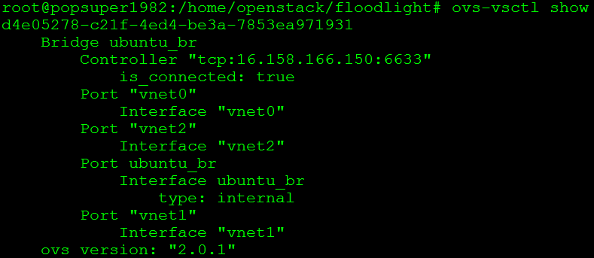
实验五：配置使用OpenFlow Controller
安装floodlight
http://www.projectfloodlight.org/getting-started/
git clone git://github.com/floodlight/floodlight.git
cd floodlight/
ant
nohup java -jar target/floodlight.jar > floodlight.log 2>&1 &
设置Controller
ovs-vsctl set-controller ubuntu_br tcp:192.168.100.1:6633

Slide 34
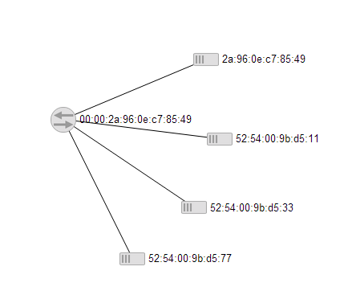
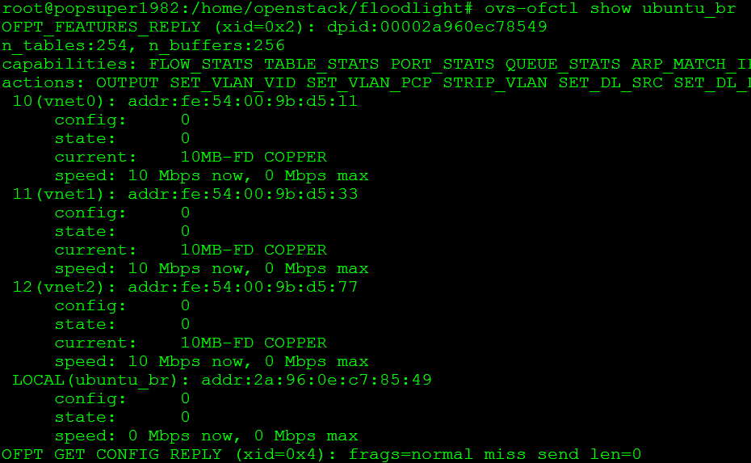
实验五：配置使用OpenFlow Controller
访问floodlight的界面
http://16.158.166.150:8080/ui/index.html
Floodlight的Rest API
http://docs.projectfloodlight.org/display/floodlightcontroller/Floodlight+REST+API
默认情况下，三台机器可以相互ping的通
ubuntu_br
Instance01
Instance02
Instance03

Slide 35
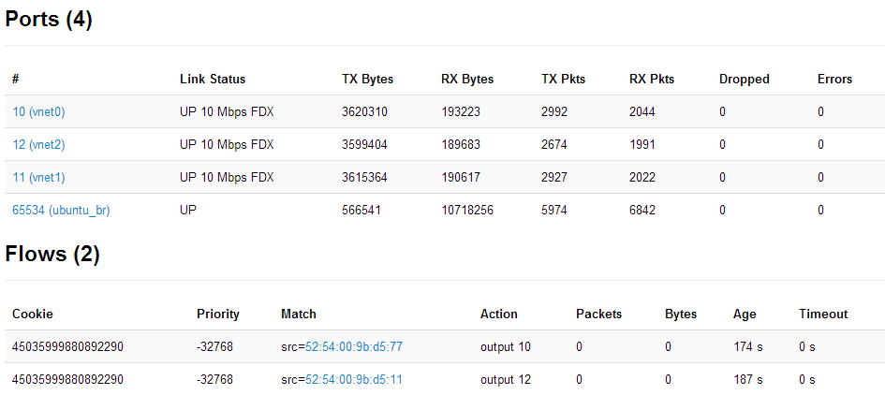
实验五：配置使用OpenFlow Controller
调用Rest API设定规则，只允许Instance01和Instance03之间相互通信
curl -d '{"switch": "00:00:2a:96:0e:c7:85:49", "name":"static-flow1", "cookie":"0", "priority":"32768", "src-mac":"52:54:00:9b:d5:11","active":"true", "actions":"output=12"}' http://16.158.166.150:8080/wm/staticflowentrypusher/json
curl -d '{"switch": "00:00:2a:96:0e:c7:85:49", "name":"static-flow2", "cookie":"0", "priority":"32768", "src-mac":"52:54:00:9b:d5:77","active":"true", "actions":"output=10"}' http://16.158.166.150:8080/wm/staticflowentrypusher/json

Slide 36
实验五：配置使用OpenFlow Controller
用REST API清除所有规则
将正确的mac导向正确的port
curl http://16.158.166.150:8080/wm/staticflowentrypusher/clear/00:00:2a:96:0e:c7:85:49/json
curl -d '{"switch": "00:00:2a:96:0e:c7:85:49", "name":"static-flow1", "cookie":"0", "priority":"32768", "dst-mac":"52:54:00:9b:d5:11","active":"true", "actions":"output=10"}' http://16.158.166.150:8080/wm/staticflowentrypusher/json
curl -d '{"switch": "00:00:2a:96:0e:c7:85:49", "name":"static-flow2", "cookie":"0", "priority":"32768", "dst-mac":"52:54:00:9b:d5:33","active":"true", "actions":"output=11"}' http://16.158.166.150:8080/wm/staticflowentrypusher/json
curl -d '{"switch": "00:00:2a:96:0e:c7:85:49", "name":"static-flow3", "cookie":"0", "priority":"32768", "dst-mac":"52:54:00:9b:d5:77","active":"true", "actions":"output=12"}' http://16.158.166.150:8080/wm/staticflowentrypusher/json

Slide 37
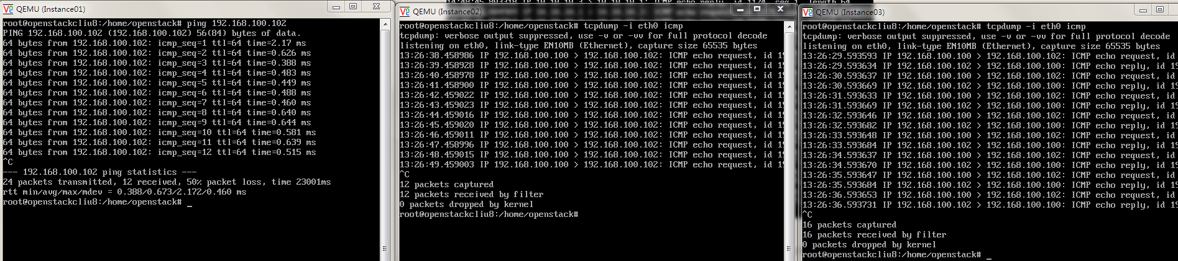
实验五：配置使用OpenFlow Controller
从Instance01来ping Instance03，用tcpdump监听Instance02和Instance03，在这个过程中，用REST API将Instance03的包转发给Instance02
curl -d '{"switch": "00:00:2a:96:0e:c7:85:49", "name":"static-flow3", "cookie":"0", "priority":"32768", "dst-mac":"52:54:00:9b:d5:77","active":"true", "actions":"output=11"}' http://16.158.166.150:8080/wm/staticflowentrypusher/json

Slide 38
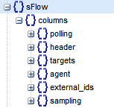
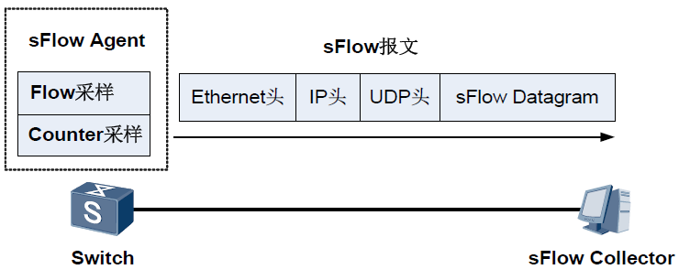
Openvswitch: sFlow, NetFlow/IPFIX
采样流sFlow（Sampled Flow）是一种基于报文采样的网络流量监控技术，主要用于对网络流量进行统计分析。
Flow 采样是sFlow Agent 设备在指定端口上按照特定的采样方向和采样比对报文进行采样分析, 该采样方式主要是关注流量的细节，这样就可以监控和分析网络上的流行为。
Counter采样是sFlow Agent设备周期性的获取接口上的流量统计信息, 只关注接口上流量的量，而不关注流量的详细信息。

Slide 39
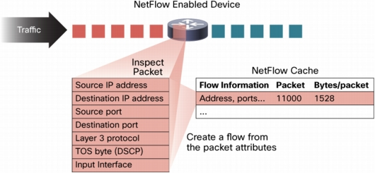
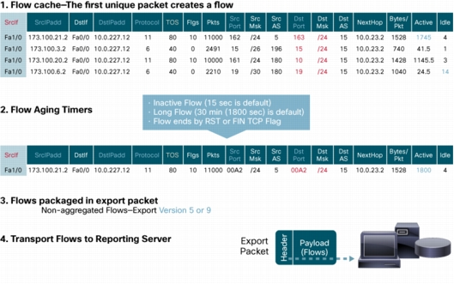
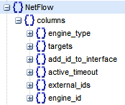
Openvswitch: sFlow, NetFlow/IPFIX
Cisco NetFlow and IPFIX (the IETF standard based on NetFlow) 也是一个协议，将流量记录发送给服务器

Slide 40
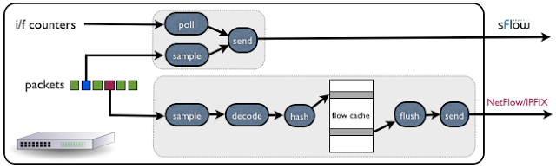
Openvswitch: sFlow, NetFlow/IPFIX
sFlow | NetFlow/IPFIX
InMon sFlowTrend | SolarWinds Real-Time NetFlow Analyzer
流量统计包括L2 | 仅仅包含L3
No Cache, real-time | With flow cache
monitor all types of traffic: ARP, IPv6, DHCP/BOOTP, STP, LLDP | IPv4 traffic
服务器负责解析包 | Switch负责解析包
ovs-vsctl -- --id=@sflow create sflow agent=eth0 target=\"16.158.49.11:6343\" header=128 sampling=512 polling=10 -- set bridge ubuntu_br sflow=@sflow ovs-vsctl list sflow ovs-vsctl -- clear Bridge ubuntu_br sflow | ovs-vsctl -- --id=@nf create NetFlow targets=\"16.158.49.11:2055\" active-timeout=60 -- set Bridge ubuntu_br netflow=@nf ovs-vsctl list NetFlow ovs-vsctl -- clear Bridge ubuntu_br NetFlow

Slide 41
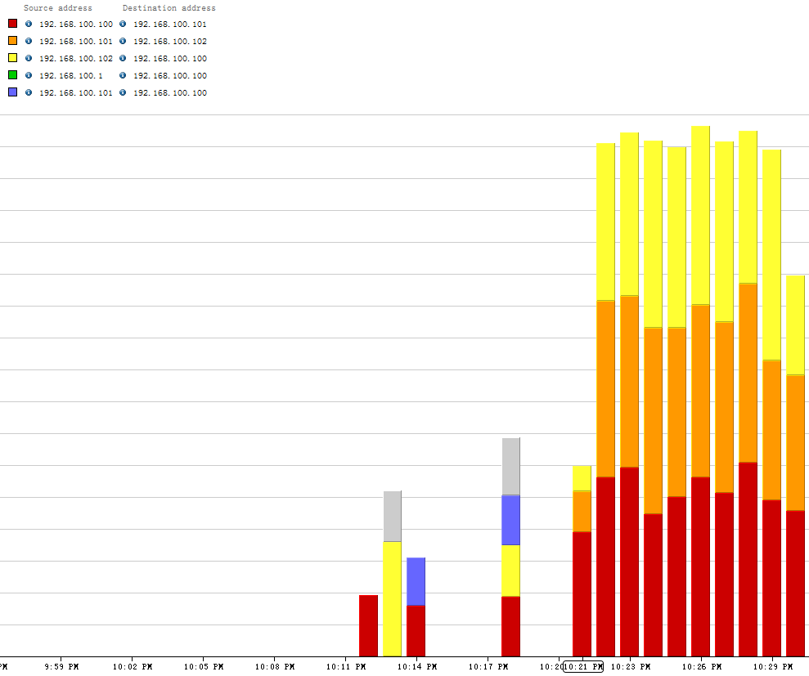

实验六: 使用sFlow和NetFlow

Slide 42

Openvswitch: Mirror
Mirror就是配置一个bridge，将某些包发给指定的mirrored ports
对于包的选择：
select_all，所有的包
select_dst_port
select_src_port
select_vlan
对于指定的目的：
output_port (SPAN Switched Port ANalyzer)
output_vlan (RSPAN Remote Switched Port ANalyzer)

Slide 43

Openvswitch: Mirror
SPAN
Source (SPAN) port -A port that is monitored with use of the SPAN feature.
Destination (SPAN) port -A port that monitors source ports, usually where a network analyzer is connected.

Slide 44

Openvswitch: Mirror
RSPAN
被监控的流量不是发送到一个指定的端口，而是Flood给指定的VLAN
监听的端口不一定要在本地switch上，可以在指定的VLAN的任意switch上
S1 is a source switch
S2 and S3 are intermediate switches
S4 and S5 are destination switches.
learning is disabled to enable flooding

Slide 45

实验七: 测试Mirror的SPAN和RSPAN
helloworld
first_if
second_if
third_br
first_br
second_br
third_if
ubuntu_br
vnet0
vnet1
vnet2
Instance01
192.168.100.101
192.168.100.102
192.168.100.100
Instance02
Instance03

Slide 46

实验七: 测试Mirror的SPAN和RSPAN
创建拓扑结构
ovs-vsctl add-br helloworld
ip link add first_br type veth peer name first_if
ip link add second_br type veth peer name second_if
ip link add third_br type veth peer name third_if
ovs-vsctl add-port ubuntu_br first_br
ovs-vsctl add-port ubuntu_br second_br -- set Port second_br tag=110
ovs-vsctl add-port helloworld second_if -- set Port second_if tag=110
ovs-vsctl add-port helloworld third_br -- set Port third_br tag=110

Slide 47

实验七: 测试Mirror的SPAN和RSPAN
在first_br上面mirror所有进出vnet0的包
监听first_if，并且从instance01里面ping 192.168.100.102
ovs-vsctl -- set bridge ubuntu_br mirrors=@m -- --id=@vnet0 get Port vnet0 -- --id=@first_br get Port first_br -- --id=@m create Mirror name=mirrorvnet0 select-dst-port=@vnet0 select-src-port=@vnet0 output-port=@first_br
Notes:
ovs-vsctl --db=tcp:10.10.50.215:6633 -- remove bridge br0 mirrors mymirror

Slide 48
实验七: 测试Mirror的SPAN和RSPAN
对进入vnet1的所有进出包，然而ouput到一个vlan 110
在helloworld中也要配置从110来的，都output到vlan 110
Disable mac address learning for vlan 110
ovs-vsctl -- set bridge ubuntu_br mirrors=@m -- --id=@vnet1 get Port vnet1 -- --id=@m create Mirror name=mirrorvnet1 select-dst-port=@vnet1 select-src-port=@vnet1 output-vlan=110
ovs-vsctl -- set bridge helloworld mirrors=@m -- --id=@m create Mirror name=mirrorvlan select-vlan=110 output-vlan=110
ovs-vsctl set bridge ubuntu_br flood-vlans=110
ovs-vsctl set bridge helloworld flood-vlans=110

Slide 49

实验七: 测试Mirror的SPAN和RSPAN
监听third_if，并且从instance02里面ping 192.168.100.102

Slide 50
实验七: 测试Mirror的SPAN和RSPAN
删除Mirror
查看ubuntu_br
ovs-vsctl list bridge ubuntu_br
清除里面的mirrors
ovs-vsctl clear Bridge ubuntu_br mirrors
清除flood_vlans
ovs-vsctl clear Bridge ubuntu_br flood_vlans
查看所有的Mirror
ovs-vsctl list Mirror
ovs-vsctl clear Bridge helloworld mirrors
ovs-vsctl clear Bridge helloworld flood_vlans

Slide 51

Openvswitch: Port
一般来说一个Port就是一个Interface，当然也有一个Port对应多个Interface的情况，成为Bond

Slide 52
Openvswitch: Port
Port的一个重要的方面就是VLAN Configuration，有两种模式：
trunk port
这个port不配置tag，配置trunks
如果trunks为空，则所有的VLAN都trunk，也就意味着对于所有的VLAN的包，本身带什么VLAN ID，就是携带者什么VLAN ID，如果没有设置VLAN，就属于VLAN 0，全部允许通过。
如果trunks不为空，则仅仅带着这些VLAN ID的包通过。
access port
这个port配置tag，从这个port进来的包会被打上这个tag
如果从其他的trunk port中进来的本身就带有VLAN ID的包，如果VLAN ID等于tag，则会从这个port发出
从其他的access port上来的包，如果tag相同，也会被forward到这个port
从access port发出的包不带VLAN ID
如果一个本身带VLAN ID的包到达access port，即便VLAN ID等于tag，也会被抛弃。

Slide 53
实验八: 测试Port的VLAN功能
first_if
second_if
third_if
192.168.100.103
192.168.100.104
192.168.100.105
first_br(tag=103)
second_br(trunk)
third_br(trunks=101,102)
ubuntu_br
vnet0(tag=101)
vnet1(tag=102)
vnet2(tag=103)
192.168.100.100
192.168.100.101
192.168.100.102
Instance01
Instance02
Instance03

Slide 54

实验八: 测试Port的VLAN功能
创建拓扑结构
ovs-vsctl add-port ubuntu_br first_br
ovs-vsctl add-port ubuntu_br second_br
ovs-vsctl add-port ubuntu_br third_br
ovs-vsctl set Port vnet0 tag=101
ovs-vsctl set Port vnet1 tag=102
ovs-vsctl set Port vnet2 tag=103
ovs-vsctl set Port first_br tag=103
ovs-vsctl clear Port second_br tag
ovs-vsctl set Port third_br trunks=101,102
需要监听ARP，所以禁止MAC地址学习
ovs-vsctl set bridge ubuntu_br flood-vlans=101,102,103

Slide 55


实验八: 测试Port的VLAN功能
从192.168.100.102来ping 192.168.100.103，应该first_if和second_if能够收到包
first_if收到包了，从first_br出来的包头是没有VLAN ID的
second_if也收到包了，由于second_br是trunk port，因而出来的包头是有VLAN ID的，103
third_if收不到包

Slide 56


实验八: 测试Port的VLAN功能
从192.168.100.100在ping 192.168.100.105, 则second_if和third_if可以收到包(当然ping不通，因为third_if不属于某个VLAN)
first_if收不到包
second_if能够收到包，而且包头里面是VLAN ID = 101
third_if也能收到包，而且包头里面是VLAN ID =101

Slide 57


实验八: 测试Port的VLAN功能
从192.168.100.101来ping 192.168.100.104, 则second_if和third_if可以收到包
first_if收不到包
second_br能够收到包，而且包头里面是VLAN ID = 102
third_if也能收到包，而且包头里面是VLAN ID =102

Slide 58
实验八: 测试Port的VLAN功能
清理环境
ovs-vsctl clear Bridge ubuntu_br flood_vlans
ovs-vsctl list Port
ovs-vsctl clear Port vnet1 tag
ovs-vsctl clear Port vnet0 tag
ovs-vsctl clear Port first_br tag
ovs-vsctl clear Port third_br trunks

Slide 59


Openvwitch: Bond
有关Interface，就不得不提Bond
Bond将设备用多个连接在一起，形成一个虚拟的连接，从而实现高可用性以及高吞吐量
很多别名：LACP Trunk, Bond, Etherchannel
LACP (Link Aggregation Control Protocol)

Slide 60
Openvwitch: Bond
bond_mode
active-backup: 一个连接是active，其他的backup，当active失效的时候，backup顶上
balance-slb: 流量安装源MAC和output VLAN进行负载均衡
balance-tcp:必须在支持LACP协议的情况下才可以，可根据L2, L3, L4进行负载均衡

Slide 61

实验九: 测试Bond功能
Instance01
Instance02
192.168.100.100
192.168.100.101
ovs-vsctl add-bond ubuntu_br bond0 first_br second_br
ovs-vsctl add-bond helloworld bond1 first_if second_if
ovs-vsctl set Port bond0 lacp=active
ovs-vsctl set Port bond1 lacp=active
vnet0
vnet1
ubuntu_br
bond0
first_br
second_br
first_if
second_if
bond1
helloworld
vnet2
vnet3
192.168.100.102
192.168.100.103
Instance03
Instance04

Slide 62

实验九: 测试Bond功能
查看Bond
查看LACP
root@popsuper1982:/home/openstack# ovs-appctl lacp/show
---- bond0 ----
status: active negotiated
sys_id: 2a:96:0e:c7:85:49
sys_priority: 65534
aggregation key: 7
lacp_time: slow
slave: first_br: current attached
port_id: 7
port_priority: 65535
may_enable: true
actor sys_id: 2a:96:0e:c7:85:49
actor sys_priority: 65534
actor port_id: 7
actor port_priority: 65535
actor key: 7
actor state: activity aggregation synchronized collecting distributing
partner sys_id: 72:d2:d3:59:8c:41
partner sys_priority: 65534
partner port_id: 3
partner port_priority: 65535
partner key: 3
partner state: activity aggregation synchronized collecting distributing
slave: second_br: current attached
port_id: 8
port_priority: 65535
may_enable: true
actor sys_id: 2a:96:0e:c7:85:49
actor sys_priority: 65534
actor port_id: 8
actor port_priority: 65535
actor key: 7
actor state: activity aggregation synchronized collecting distributing
partner sys_id: 72:d2:d3:59:8c:41
partner sys_priority: 65534
partner port_id: 4
partner port_priority: 65535
partner key: 3
partner state: activity aggregation synchronized collecting distributing
---- bond1 ----
status: active negotiated
sys_id: 72:d2:d3:59:8c:41
sys_priority: 65534
aggregation key: 3
lacp_time: slow
slave: first_if: current attached
port_id: 3
port_priority: 65535
may_enable: true
actor sys_id: 72:d2:d3:59:8c:41
actor sys_priority: 65534
actor port_id: 3
actor port_priority: 65535
actor key: 3
actor state: activity aggregation synchronized collecting distributing
partner sys_id: 2a:96:0e:c7:85:49
partner sys_priority: 65534
partner port_id: 7
partner port_priority: 65535
partner key: 7
partner state: activity aggregation synchronized collecting distributing
slave: second_if: current attached
port_id: 4
port_priority: 65535
may_enable: true
actor sys_id: 72:d2:d3:59:8c:41
actor sys_priority: 65534
actor port_id: 4
actor port_priority: 65535
actor key: 3
actor state: activity aggregation synchronized collecting distributing
partner sys_id: 2a:96:0e:c7:85:49
partner sys_priority: 65534
partner port_id: 8
partner port_priority: 65535
partner key: 7
partner state: activity aggregation synchronized collecting distributing

Slide 63

实验九: 测试Bond功能
默认情况下bond_mode是active-backup模式，一开始active的是first_br和first_if
从192.168.100.100 ping 192.168.100.102，以及192.168.100.101 ping 192.168.100.103，都是从first_if通过

Slide 64

实验九: 测试Bond功能
如果把first_if设成down，则包的走向会变
ip link set first_if down
发现second_if开始有流量，京first_if变成down, 192.168.100.100和192.168.100.101似乎没有收到影响
second_br和second_if变成active

Slide 65

实验九: 测试Bond功能
重启first_if，但是second_br和second_if仍然是active
ip link set first_if up

Slide 66
实验九: 测试Bond功能
把bond_mode设为balance-slb
ovs-vsctl set Port bond0 bond_mode=balance-slb
ovs-vsctl set Port bond1 bond_mode=balance-slb
同时192.168.100.100 ping 192.168.100.102,192.168.100.101 ping 192.168.100.103, 已经分流了
把bond_mode设为balance-tcp
ovs-vsctl set Port bond0 bond_mode=balance-tcp
ovs-vsctl set Port bond1 bond_mode=balance-tcp
同时在192.168.100.100上：netperf -H 192.168.100.102 -t UDP_STREAM -- -m 1024
在192.168.100.101上： netperf -H 192.168.100.103 -t UDP_STREAM -- -m 1024
Notes:
ovs-vsctl del-port bond0
ovs-vsctl del-port bond1

Slide 67
Openvswitch: QoS
ingress
Linux
Policy
Shaping
egress
Notes:
http://lartc.org/howto/
http://tldp.org/HOWTO/Traffic-Control-HOWTO/

Slide 68




Openvswitch: QoS
Classless Queuing Disciplines
默认为pfifo_fast

Slide 69

Openvswitch: QoS
SFQ, Stochastic Fair Queuing
有很多的FIFO的队列，TCP Session或者UDP stream会被分配到某个队列。包会RoundRobin的从各个队列中取出发送。
这样不会一个Session占据所有的流量。
但不是每一个Session都有一个队列，而是有一个Hash算法，将大量的Session分配到有限的队列中。
这样两个Session会共享一个队列，也有可能互相影响。
Hash函数会经常改变，从而session不会总是相互影响。

Slide 70

Openvswitch: QoS
TBF, Token Bucket Filter
两个概念Tokens and buckets
所有的包排成队列进行发送，但不是到了队头就能发送，而是需要拿到Token才能发送
Token根据设定的速度rate生成，所以即便队列很长，也是按照rate进行发送的
当没有包在队列中的时候，Token还是以既定的速度生成，但是不是无限累积的，而是放满了buckets为止，篮子的大小常用burst/buffer/maxburst来设定
Buckets会避免下面的情况：当长时间没有包发送的时候，积累了大量的Token，突然来了大量的包，每个都能得到Token，造成瞬间流量大增

Slide 71

Openvswitch: QoS
Classful Queuing Disciplines
HTB, Hierarchical Token Bucket
Shaping：仅仅发生在叶子节点，依赖于其他的Queue
Borrowing: 当网络资源空闲的时候，借点过来为我所用
Rate：设定的发送速度
Ceil：最大的速度，和rate之间的差是最多能向别人借多少
type of class | class state | HTB internal state | action taken
leaf | < rate | HTB_CAN_SEND | Leaf class will dequeue queued bytes up to available tokens (no more than burst packets)
leaf | > rate, < ceil | HTB_MAY_BORROW | Leaf class will attempt to borrow tokens/ctokens from parent class. If tokens are available, they will be lent in quantum increments and the leaf class will dequeue up to cburst bytes
leaf | > ceil | HTB_CANT_SEND | No packets will be dequeued. This will cause packet delay and will increase latency to meet the desired rate.
inner, root | < rate | HTB_CAN_SEND | Inner class will lend tokens to children.
inner, root | > rate, < ceil | HTB_MAY_BORROW | Inner class will attempt to borrow tokens/ctokens from parent class, lending them to competing children in quantum increments per request.
inner, root | > ceil | HTB_CANT_SEND | Inner class will not attempt to borrow from its parent and will not lend tokens/ctokens to children classes.
Notes:
http://luxik.cdi.cz/~devik/qos/htb/manual/userg.htm

Slide 72

Openvswitch: QoS

Slide 73
Openvswitch: QoS
创建一个HTB的qdisc在eth0上，句柄为1:，default 12表示默认发送给1:12
tc qdisc add dev eth0 root handle 1: htb default 12
创建一个root class，然后创建几个子class
同一个root class下的子类可以相互借流量，如果直接不在qdisc下面创建一个root class，而是直接创建三个class，他们之间是不能相互借流量的。
tc class add dev eth0 parent 1: classid 1:1 htb rate 100kbps ceil 100kbps
tc class add dev eth0 parent 1:1 classid 1:10 htb rate 30kbps ceil 100kbps
tc class add dev eth0 parent 1:1 classid 1:11 htb rate 10kbps ceil 100kbps
tc class add dev eth0 parent 1:1 classid 1:12 htb rate 60kbps ceil 100kbps
创建叶子qdisc，分别为fifo和sfq
tc qdisc add dev eth0 parent 1:10 handle 20: pfifo limit 5
tc qdisc add dev eth0 parent 1:11 handle 30: pfifo limit 5
tc qdisc add dev eth0 parent 1:12 handle 40: sfq perturb 10
设定规则：从1.2.3.4来的，发送给port 80的包，从1:10走；其他从1.2.3.4发送来的包从1:11走；其他的走默认
tc filter add dev eth0 protocol ip parent 1:0 prio 1 u32 match ip src 1.2.3.4 match ip dport 80 0xffff flowid 1:10
tc filter add dev eth0 protocol ip parent 1:0 prio 1 u32 match ip src 1.2.3.4 flowid 1:11

Slide 74


Openvswitch: QoS
时间0的时候，0,1,2都以90k的速度发送数据，在时间3的时候，将0的发送停止，红色的线归零，剩余的流量按照比例分给了蓝色的和绿色的线。
在时间6的时候，将0的发送重启为90k，则蓝色和绿色的流量返还给红色的流量。
在时间9的时候，将1的发送停止，绿色的流量为零，剩余的流量按照比例分给了蓝色和红色。
在时间12,将1的发送恢复，红色和蓝色返还流量。
在时间15，将2的发送停止，蓝色流量为零，剩余的流量按照比例分给红色和绿色。
在时间19，将1的发送停止，绿色的流量为零，所有的流量都归了红色。

Slide 75
Openvswitch: QoS
Openvswitch支持两种：
Ingress policy
ovs-vsctl set Interface tap0 ingress_policing_rate=100000
ovs-vsctl set Interface tap0 ingress_policing_burst=10000
Egress shaping: Port QoS policy 仅支持HTB
在port上可以创建QoS
一个QoS可以有多个Queue
规则通过Flow设定
QoS
Queue

Slide 76

实验十: 测试QoS功能
Instance01
Instance02
Instance03
192.168.100.100
192.168.100.101
192.168.100.102
vnet0
vnet1
vnet2
ubuntu_br
first_br
first_if
helloworld
vnet3
192.168.100.103
Instance04

Slide 77


实验十: 测试QoS功能
在什么都没有配置的时候，测试一下速度，从192.168.100.100 netperf 192.168.100.103
设置 一下first_if
ovs-vsctl set Interface first_if ingress_policing_rate=100000
ovs-vsctl set Interface first_if ingress_policing_burst=10000

Slide 78
实验十: 测试QoS功能
清理现场
ovs-vsctl set Interface first_if ingress_policing_burst=0
ovs-vsctl set Interface first_if ingress_policing_rate=0
ovs-vsctl list Interface first_if
添加QoS
添加Flow(first_br是ubuntu_br上的port 5)
ovs-vsctl set port first_br qos=@newqos -- --id=@newqos create qos type=linux-htb other-config:max-rate=10000000 queues=0=@q0,1=@q1,2=@q2 -- --id=@q0 create queue other-config:min-rate=3000000 other-config:max-rate=10000000 -- --id=@q1 create queue other-config:min-rate=1000000 other-config:max-rate=10000000 -- --id=@q2 create queue other-config:min-rate=6000000 other-config:max-rate=10000000
ovs-ofctl add-flow ubuntu_br "in_port=6 nw_src=192.168.100.100 actions=enqueue:5:0"
ovs-ofctl add-flow ubuntu_br "in_port=7 nw_src=192.168.100.101 actions=enqueue:5:1"
ovs-ofctl add-flow ubuntu_br "in_port=8 nw_src=192.168.100.102 actions=enqueue:5:2"

Slide 79

实验十: 测试QoS功能

Slide 80


实验十: 测试QoS功能
单独测试从192.168.100.100，192.168.100.101，192.168.100.102到192.168.100.103
如果三个一起测试，发现是按照比例3:1:6进行的

Slide 81



实验十: 测试QoS功能
如果Instance01和Instance02一起，则3:1
如果Instance01和Instance03一起，则1:2
如果Instance02和Instance03一起，则1:6

Slide 82




实验十: 测试QoS功能
清理环境
Notes:
ovs-ofctl add-flow ubuntu_br action=normal

Slide 83

Openvswitch: Tunnel
gre
vxlan
ipsec_gre

Slide 84

Openvswitch: Tunnel GRE
Generic Routing Encapsulation (GRE) is a tunneling protocol that can encapsulate a wide variety of network layer protocols inside virtual point-to-point links over an Internet Protocol internetwork.

Slide 85

Openvswitch: Tunnel GRE
GRE Header
从L2到L3，数据可打包后跨越网关和路由器然后解包称为L2的数据

Slide 86

Openvswitch: Tunnel GRE
缺点：
点对点，扩展性不好
网络设备对GRE包头支持有限，往往负载均衡和防火墙ACL都是根据IP和Port来的。

Slide 87
Openvswitch: Tunnel VXLAN
VXLAN：通过对L2包的打包和解包实现不同的L2网络感觉在同一个L2网络里面
Components:
Multicast support, IGMP and PIM
VXLAN Network Identifier (VNI): 24-bit segment ID
VXLAN Gateway
VXLAN Tunnel End Point (VTEP)
VXLAN Segment/VXLAN Overlay Network

Slide 88

Openvswitch: Tunnel VXLAN
Ethernet Header:
Destination Address MAC address of the destination VTEP if it is local, MAC addr of gateway when the destination VTEP is on a different L3 network.
IP Header:
Protocol – Set 0×11 to indicate that the frame contains a UDP packet
Source IP – IP address of originating VTEP
Destination IP – IP address of target VTEP.
UDP Header:
Source Port – Set by transmitting VTEP
VXLAN Port – IANA assigned VXLAN Port.
VXLAN Header:
VNI – 24-bit field that is the VXLAN Network Identifier
Notes:
in the case of a target virtual machine that the VTEP has not targeted before, a discovery process needs to be done by originating VTEP.
Destination IP is replaced with the IP multicast group corresponding to the VNI of the originating virtual machine
All VTEPs that have subscribed to the IP multicast group receive the frame and decapsulate it learning the mapping of source virtual machine MAC address and host VTEP
The host VTEP of the destination virtual machine will then send the virtual machines response to the originating VTEP using its destination IP address as it learned this from the original multicast frame
The Source VTEP adds the new mapping of VTEP to virtual machine MAC address to its tables for future packets

Slide 89



Openvswitch: Tunnel VXLAN
ARP
VM1
MAC1
VTEP1
IGMP report: 加入组239.119.1.1
VM2
MAC2
VTEP2
IGMP report: 加入组239.119.1.1
L2/L3 network
infrastructure
VM1及VM2连接到VXLAN网络100, 两个VXLAN主机加入IP多播组239.119.1.1
VTEP – VXLAN隧道终端 (VXLAN Tunneling End Point)1

Slide 90

Openvswitch: Tunnel VXLAN
ARP
VM1
MAC1
VM2
MAC2
1
BCAST
MAC1
ARP Req
5
BCAST
MAC1
ARP
Req
4 学习内层MAC到外层源IP地址
的映射
NetID | MAC | IP
NetID | MAC | IP
100 | MAC1 | IP1_vtep1
VTEP1
VTEP2
2
用IP多播封装原广播报文
3 封装后的报文经多播转发到达
MAC Hdr
IP Hdr
UDP Hdr
VXLAN Hdr
BCAST
MAC1
ARP
MAC Hdr
IP Hdr
UDP Hdr
VXLAN Hdr
BCAST
MAC1
ARP
DA:239.119.1.1
VXLAN ID:
Req
DA:239.119.1.1
VXLAN ID:
Req
SA:IP_vtep1
100
SA:IP_vtep1
100
L2/L3 网络
VM1发送ARP请求(广播)以获得VM2的MAC地址，VXLAN ID为100
VTEP – VXLAN隧道终端 (VXLAN Tunneling End Point)12

Slide 91

Openvswitch: Tunnel VXLAN
ARP
VM1
MAC1
VM2
MAC2
4
MAC1
MAC2
ARP
1
MAC1
MAC2
ARP
Resp
Resp
3 学习内层MAC到外层源IP地址的映射
NetID | MAC | IP
100 | MAC2 | IP_vtep2
NetID | MAC | IP
100 | MAC1 | IP_vtep1
VTEP1
VTEP2
2 已知MAC1的外层IP地址, 使用IP单播封装
MAC Hdr
IP Hdr
DA:IP_vtep1
SA:IP_vtep2
UDP Hdr
VXLAN Hdr
VXLAN ID:
100
MAC1
MAC2
ARP
Resp
MAC Hdr
IP Hdr
DA:IP_vtep1
SA:IP_vtep2
UDP Hdr
VXLAN Hdr
VXLAN ID:
100
MAC1
MAC2
ARP
Resp
L2/L3 网络
VM2发送ARP应答(单播)到VM1
VTEP – VXLAN隧道终端 (VXLAN Tunneling End Point)3

Slide 92

Openvswitch: Tunnel VXLAN
Notes:
When VM1 wants to send a packet to VM2, it needs the MAC address of VM2 this is the process that is followed:
VM1 sends a ARP packet requesting the MAC address associated with 192.168.0.101
This ARP is encapsulated by VTEP1 into a multicast packet to the multicast group associated with VNI 864
All VTEPs see the multicast packet and add the association of VTEP1 and VM1 to its VXLAN tables
VTEP2 receives the multicast packet decapsulates it, and sends the original broadcast on portgroups associated with VNI 864
VM2 sees the ARP packet and responds with its MAC address
VTEP2 encapsulates the response as a unicast IP packet and sends it back to VTEP1 using IP routing
VTEP1 decapsulates the packet and passes it on to VM1
At this point VM1 knows the MAC address of VM2 and can send directed packets to it as shown in in Figure 2: VM to VM communication:
VM1 sends the IP packet to VM2 from IP address 192.168.0.100 to 192.168.0.101
VTEP1 takes the packet and encapsulates it by adding the following headers:
VXLAN header with VNI=864
Standard UDP header and sets the UDP checksum to 0×0000, and the destination port being the VXLAN IANA designated port. Cisco N1KV is currently using port ID 8472.
Standard IP header with the Destination being VTEP2’s IP address and Protocol 0×011 for the UDP packet used for delivery
Standard MAC header with the MAC address of the next hop. In this case it is the router Interface with MAC address 00:10:11:FE:D8:D2 which will use IP routing to send it to the destination
VTEP2 receives the packet as it has it’s MAC address as the destination. The packet is decapsulated and found to be a VXLAN packet due to the UDP destination port. At this point the VTEP will look up the associated portgroups for VNI 864 found in the VXLAN header. It will then verify that the target, VM2 in this case, is allowed to receive frames for VNI 864 due to it’s portgroup membership and pass the packet on if the verification passes.
VM2 receives the packet and deals with it like any other IP packet.

Slide 93
Openvswitch: Tunnel VXLAN
可支持Multicast，但是在数据中心常被禁止
硬件支持广泛

Slide 94

Openvswitch: Tunnel GRE over IPSec
安全通道，安全意味着
信息完整性——认证
信息的私密性——加密
信息不会被Replay
完整性及加密算法
完整性
对称加密
连接维护
完整性和加密
对称加密
密匙交换

Slide 95

Openvswitch: Tunnel GRE over IPSec
Security Association
IPSec Key Exchange (IKE)
Internet Security Association and Key Management Protocol (ISAKMP)
ID
Partner IP
Ipsec Protocal (ESP/AH)
Security Parameters Index (SPI)
Infos
ESP encryption algorithm
ESP encryption secret key
ESP Authentication
……

Slide 97


crypto isakmp policy 200
encryption aes 128
authentication pre-share
group 2
lifetime 28800
hash sha
exit
crypto keyring keyring-vpn-44a8938f-0
pre-shared-key address 72.21.209.225 key plain-text-password1
exit
crypto isakmp profile isakmp-vpn-44a8938f-0
match identity address 72.21.209.225
keyring keyring-vpn-44a8938f-0
exit
crypto ipsec transform-set ipsec-prop-vpn-44a8938f-0 esp-aes 128 esp-sha-hmac
mode tunnel
exit
crypto ipsec profile ipsec-vpn-44a8938f-0
set pfs group2
set security-association lifetime seconds 3600
set transform-set ipsec-prop-vpn-44a8938f-0
exit
interface Tunnel1
ip address 169.254.255.2 255.255.255.252
ip virtual-reassembly
tunnel source YOUR_UPLINK_ADDRESS
tunnel destination 72.21.209.225
tunnel mode ipsec ipv4
tunnel protection ipsec profile ipsec-vpn-44a8938f-0
ip tcp adjust-mss 1396
no shutdown
exit

Slide 98
Openvswitch: Tunnel GRE over IPSec

Slide 99

实验十一：创建Tunnel
Instance01
Instance02
10.0.0.1
10.0.0.2
vxlan
GRE
GRE
IPSec
192.168.100.100
192.168.100.101
vnet0
vnet1
ubuntu_br
vnet2
192.168.100.102
Instance03
vxlan
IPSec
10.0.0.3
Notes:
ovs−vsctl add−port br0 gre0 −− set Interface gre0 type=gre options:remote_ip=1.2.3.4

Slide 100
实验十一：创建Tunnel
在虚拟机Instance01上
在虚拟机Instance02上
在虚拟机Instance03上
ovs-vsctl add-br testbr
ifconfig testbr 10.0.0.1/24
ovs-vsctl add-port testbr gre0 -- set Interface gre0 type=gre options:local_ip=192.168.100.100 options:remote_ip=192.168.100.101
ovs-vsctl add-port testbr vxlan0 -- set Interface vxlan0 type=vxlan options:local_ip=192.168.100.100 options:remote_ip=192.168.100.102
ovs-vsctl add-br testbr
ifconfig testbr 10.0.0.2/24
ovs-vsctl add-port testbr gre0 -- set Interface gre0 type=gre options:local_ip=192.168.100.101 options:remote_ip=192.168.100.100
ovs-vsctl add-port testbr ipsec0 -- set Interface ipsec0 type=ipsec_gre options:local_ip=192.168.100.101 options:remote_ip=192.168.100.102 options:psk=password
ovs-vsctl add-br testbr
ifconfig testbr 10.0.0.3/24
ovs-vsctl add-port testbr vxlan0 -- set Interface vxlan0 type=vxlan options:local_ip=192.168.100.102 options:remote_ip=192.168.100.100
ovs-vsctl add-port testbr ipsec0 -- set Interface ipsec0 type=ipsec_gre options:local_ip=192.168.100.102 options:remote_ip=192.168.100.101 options:psk=password

Slide 101
实验十一：创建Tunnel
不好，出现了环，没关系enable STP
监听Instance01的eth0: tcpdump -n -e -i eth0
监听Instance02的eth0: tcpdump -n -e -i eth0
监听Instance03的eth0: tcpdump -n -e -i eth0
ovs-vsctl set Bridge testbr stp_enable=true

Slide 102

Openvswitch: STP
The Spanning Tree Protocol (STP)

Slide 103

Openvswitch: STP

Slide 104
Openvswitch: STP
Root Bridge: 树根，整棵STP树的老大，是掌门，最大的大哥
Designated Bridges: 我拜谁做大哥
Bridge Protocol Data Units (BPDUs) 相互比较实力的协议
STP (802.1D-1998)
RSTP (802.1D-2002 or 802.1w)
MSTP (802.1Q-2002 or 802.1s)
Priority Vector 实力 (值越小越牛)
[Root Bridge ID, Root Path Cost, Bridge ID, and Port ID]
Root Bridge ID我当前的老大的ID，先拿掌门比
Root Path Cost我距离我当前的老大的距离，再拿和掌门关系比
Bridge ID我自己的ID，再拿自己的本事比

Slide 105
Openvswitch: STP
STP协商过程，选举武林盟主
BPDU只有掌门发，已经隶属于某个掌门的bridge不发，仅仅传达掌门指示
开始启动的时候，都认为自己是掌门，向周围展现实力
掌门与掌门相遇：
赢得当掌门，输的当小弟，小弟的小弟也跟随新的掌门
掌门与自己小弟相遇：已经顺从，无需处理
掌门与其他帮派小弟相遇：
小弟拿本帮掌门和这个掌门比较，赢了，这个掌门拜入门来
输了，会拜入新掌门，并且逐渐的将与自己连接的兄弟弃暗投明，最终原来的掌门也拜入门
同门小弟相遇，比较和掌门的关系，近的当大哥
不同门小弟相遇
各自拿掌门比较，输了的拜入赢得掌门门派，并且逐渐的将与自己连接的兄弟弃暗投明，最终原来的掌门也拜入门

Slide 106
1
1
1
2
2
3
2
2
3
2
3
2
5
5
5
2
3
5
2
3
5
2
3
5
2
2
2
3
3
1
3
1
1
4
6
4
6
4
6
(1)
(2)
(3)
1
1
1
3
2
2
3
2
2
3
2
2
5
5
5
2
3
5
2
3
5
2
3
5
2
2
2
1
3
1
3
1
3
4
6
4
6
4
6
(4)
(5)
(6)

Slide 107

实验十二：测试STP
在Instance01上
在Instance02上
在Instance03上

Slide 108
实验十二：测试STP
Instance01
Instance02
Instance01
Instance02
testbr
testbr
testbr
testbr
19
19
19
19 -> 190
Instance03
Instance03
testbr
testbr
验证：从Instance01 ping Instance02，需要经过Instance03
从Instance01 ping Instance03，不需要经过Instance02

Slide 109

实验十二：测试STP
在Instance02和Instance3上运行
ovs-vsctl set Port ipsec0 other_config:stp-path-cost=190
Instance01
Instance02
Instance03

Slide 110
Openvswitch: 直接操作DB
尽管ovs-vsctl提供了很多命令直接操作Bridge, Port, Interface, Controller, Manager, SSL等，还是有很多的属性，没有直接命令去操作，需要通过修改和查看数据库来进行
数据库的schema可以通过ovsdb-client查看
修改数据库内容通过ovs-vsctl来进行

Slide 111

实验十三：查看DB的schema

Slide 112
实验十三：查看DB的schema
ovsdb-client get-schema Open_vSwitch
ovsdb-client dump

Slide 113
实验十四：查看和修改DB的内容
准备环境
ovs-vsctl add-br helloworld
ip link add first_br type veth peer name first_if
ip link set first_br up
ip link set first_if up
ovs-vsctl add-port helloworld first_br
list table
ovs-vsctl list Bridge
list table [record]
ovs-vsctl list Bridge helloworld
get table record [column[:key]]
ovs-vsctl get Bridge helloworld ports
set table record column[:key]=value
ovs-vsctl set Port first_br tag=100
add table record column [key=]value
ovs-vsctl add Port first_br trunks 110

Slide 114
实验十四：查看和修改DB的内容
remove table record column key
ovs-vsctl remove Port first_br trunks 100
clear table record column
ovs-vsctl clear Port first_br trunks

Slide 115
Openvswitch: Flow Table
对于Flow Table的管理，由ovs-ofctl来控制
add−flow switch flow
mod−flows switch flow
del−flows switch [flow]
Match Field
Actions

Slide 116

Openvswitch: Flow Table
icmp_type=type
icmp_code=code
tp_src=port
tp_dst=port
1
6
nw_proto
arp_sha=xx:xx:xx:xx:xx:xx
arp_tha=xx:xx:xx:xx:xx:xx
nw_src=ip[/netmask]
nw_dst=ip[/netmask]
0x0806
0x0800
dl_type
dl_src=xx:xx:xx:xx:xx:xx/xx:xx:xx:xx:xx:xx
dl_dst=xx:xx:xx:xx:xx:xx/xx:xx:xx:xx:xx:xx
dl_vlan=vlan
in_port=port
Notes:
dl_dst=01:00:00:00:00:00/01:00:00:00:00:00 matches all multicast (including broadcast) Ethernet packets
dl_dst=00:00:00:00:00:00/01:00:00:00:00:00 matches all unicast Ethernet packets.
When dl_type=0x0800, nw_src=ip and nw_dst=ip 指定IP地址
When dl_type=0x0806, arp_sha and arp_tha match the source and target hardware address
When dl_type=0x0800, nw_proto=proto, 1 to match ICMP packets or 6 to match TCP packets
When dl_type and nw_proto specify ICMP, icmp_type matches the ICMP type and code matches the ICMP code.
When dl_type and nw_proto specify TCP or UDP, tp_src and tp_dst match the UDP or TCP source or destination port port

Slide 117
Openvswitch: Flow Table
Actions:
output:port 和 output:NXM_NX_REG0[16..31]
enqueue:port:queue
mod_vlan_vid:vlan_vid
strip_vlan
mod_dl_src:mac 和 mod_dl_dst:mac
mod_nw_src:ip 和 mod_nw_dst:ip
mod_tp_src:port 和 mod_tp_dst:port
set_tunnel:id
resubmit([port],[table])
move:src[start..end]−>dst[start..end]
load:value−>dst[start..end]
learn(argument[,argument]...)
Notes:
output:NXM_NX_REG0[16..31] outputs to the OpenFlow port number written in the upper half of register 0.
resubmit([port],[table]) Re-searches this OpenFlow flow table (or the table whose number is specified by table) with the in_port field replaced by port
move:src[start..end]−>dst[start..end] Copies the named bits from field src to field dst. src and dst must be NXM field names as defined in nicira−ext.h
load:value−>dst[start..end] load:55−>NXM_NX_REG2[0..5] loads value 55 (bit pattern 110111) into bits 0 through 5, inclusive, in register 2.
learn(argument[,argument]...) This action adds or modifies a flow in an OpenFlow table, similar to ovs−ofctl −−strict mod−flows.
table=number
The table in which the new flow should be inserted. Specify a decimal number between 0 and 254.

Slide 118
实验十五：模拟Openstack中Flow的操作
Instance01
Instance02
Instance03
10.0.0.1
10.0.1.1
10.0.0.2
10.0.1.2
10.0.0.3
10.0.1.3
Tag 1
Tag 2
Tag 1
Tag 2
Tag 1
Tag 2
br-int
br-int
br-int
1
1
1
br-tun
br-tun
br-tun
2
3
2
3
2
3
GRE
Notes:
/////////table 0
删除所有的Flow
ovs-ofctl del-flows br-tun
从port 1进来的，由table 1处理
ovs-ofctl add-flow br-tun "hard_timeout=0 idle_timeout=0 priority=1 in_port=1 actions=resubmit(,1)"
从port 2进来的，由Table 3处理
ovs-ofctl add-flow br-tun "hard_timeout=0 idle_timeout=0 priority=1 in_port=2 actions=resubmit(,3)"
默认丢弃
ovs-ofctl add-flow br-tun "hard_timeout=0 idle_timeout=0 priority=0 actions=drop"
/////////table 1
对于单播，由table 20处理
ovs-ofctl add-flow br-tun "hard_timeout=0 idle_timeout=0 priority=1 table=1 dl_dst=00:00:00:00:00:00/01:00:00:00:00:00 actions=resubmit(,20)"
对于多播，由table 21处理
ovs-ofctl add-flow br-tun "hard_timeout=0 idle_timeout=0 priority=1 table=1 dl_dst=01:00:00:00:00:00/01:00:00:00:00:00 actions=resubmit(,21)"
////////table 2
默认丢弃
ovs-ofctl add-flow br-tun "hard_timeout=0 idle_timeout=0 priority=0 table=2 actions=drop"
///////table 3
默认丢弃
ovs-ofctl add-flow br-tun "hard_timeout=0 idle_timeout=0 priority=0 table=3 actions=drop"
ovs-ofctl add-flow br-tun "hard_timeout=0 idle_timeout=0 priority=1 table=3 tun_id=0x1 actions=mod_vlan_vid:1,resubmit(,10)"
ovs-ofctl add-flow br-tun "hard_timeout=0 idle_timeout=0 priority=1 table=3 tun_id=0x2 actions=mod_vlan_vid:2,resubmit(,10)"
//////table 10
ovs-ofctl add-flow br-tun "hard_timeout=0 idle_timeout=0 priority=1 table=10 actions=learn(table=20,priority=1,hard_timeout=300,NXM_OF_VLAN_TCI[0..11],NXM_OF_ETH_DST[]=NXM_OF_ETH_SRC[],load:0->NXM_OF_VLAN_TCI[],load:NXM_NX_TUN_ID[]->NXM_NX_TUN_ID[],output:NXM_OF_IN_PORT[]),output:1"
//////table 20
如果没有学习到什么，直接到21，如果原来学习到一些规则，则按照规则处理
ovs-ofctl add-flow br-tun "hard_timeout=0 idle_timeout=0 priority=0 table=20 actions=resubmit(,21)"
/////table 21
默认丢弃
ovs-ofctl add-flow br-tun "hard_timeout=0 idle_timeout=0 priority=0 table=21 actions=drop"
ovs-ofctl add-flow br-tun "hard_timeout=0 idle_timeout=0 priority=0 table=21 dl_vlan=1 actions=strip_vlan,set_tunnel:0x1,output:2"
ovs-ofctl add-flow br-tun "hard_timeout=0 idle_timeout=0 priority=0 table=21 dl_vlan=2 actions=strip_vlan,set_tunnel:0x2,output:2"
我们再来分析一个实践中，openstack中使用openvswitch的情况，这是br-tun上的规则。
cookie=0x0, duration=802188.071s, table=10, n_packets=4885, n_bytes=347789, idle_age=730, hard_age=65534, priority=1 actions=learn(table=20,hard_timeout=300,priority=1,NXM_OF_VLAN_TCI[0..11],NXM_OF_ETH_DST[]=NXM_OF_ETH_SRC[],load:0->NXM_OF_VLAN_TCI[],load:NXM_NX_TUN_ID[]->NXM_NX_TUN_ID[],output:NXM_OF_IN_PORT[]),output:1
cookie=0x0, duration=802187.786s, table=20, n_packets=0, n_bytes=0, idle_age=65534, hard_age=65534, priority=0 actions=resubmit(,21)
cookie=0x0, duration=802038.514s, table=20, n_packets=1239, n_bytes=83620, idle_age=735, hard_age=65534, priority=2,dl_vlan=1,dl_dst=fa:16:3e:7e:ab:cc actions=strip_vlan,set_tunnel:0x3e9,output:2
cookie=0x0, duration=802187.653s, table=21, n_packets=17, n_bytes=1426, idle_age=65534, hard_age=65534, priority=0 actions=drop
cookie=0x0, duration=802055.878s, table=21, n_packets=40, n_bytes=1736, idle_age=65534, hard_age=65534, dl_vlan=1 actions=strip_vlan,set_tunnel:0x3e9,output:2
这里table 10是用来学习的。table 20是learning table。如果table 20是空的，也即还没有学到什么，则会通过priority=0的规则resubmit到table 21.
table 21是发送规则，将br-int上的vlan tag消除，然后打上gre tunnel的id。
上面的情况中，table 20不是空的，也即发送给dl_dst=fa:16:3e:7e:ab:cc的包不用走默认规则，直接通过table 20就发送出去了。
table 20的规则是通过table 10学习得到的，table 10是一个接受规则。最终output 1，发送给了br-int
NXM_OF_VLAN_TCI[0..11]是记录vlan tag，所以学习结果中有dl_vlan=1
NXM_OF_ETH_DST[]=NXM_OF_ETH_SRC[]是将mac source address记录，所以结果中有dl_dst=fa:16:3e:7e:ab:cc
load:0->NXM_OF_VLAN_TCI[]意思是发送出去的时候，vlan tag设为0，所以结果中有actions=strip_vlan
load:NXM_NX_TUN_ID[]->NXM_NX_TUN_ID[]意思是发出去的时候，设置tunnul id，所以结果中有set_tunnel:0x3e9
output:NXM_OF_IN_PORT[]意思是发送给哪个port，由于是从port2进来的，因而结果中有output:2

Slide 119
Table 0
in_port=1
in_port=2/3
To T1
drop
To T3
Table 1
Table 3
unicast
multicast
To T20
To T21
drop
根据tunid设置vlanid
To T10
Table 2
Table 10
drop
学习MAC
发送port 1
Table 20
有MAC规则
To T21
根据vlanid设置tunid
发送port 2/3
Table 21
drop
根据vlanid设置tunid
发送port 2/3

Slide 120

实验十五：模拟Openstack中Flow的操作
配置拓扑结构：在三台机器上都运行
ovs-vsctl add-br br-int
ovs-vsctl add-br br-tun
ip link add br-int-pair type veth peer name br-tun-pair
ip link set br-int-pair up
ip link set br-tun-pair up
ovs-vsctl add-port br-int br-int-pair
ovs-vsctl add-port br-tun br-tun-pair
ip link add vnic0 type veth peer name vnic0-br-int
ip link set vnic0 up
ip link set vnic0-br-int up
ovs-vsctl add-port br-int vnic0-br-int
ifconfig vnic0 10.0.0.1/24
ip link add vnic1 type veth peer name vnic1-br-int
ip link set vnic1 up
ip link set vnic1-br-int up
ovs-vsctl add-port br-int vnic1-br-int
ifconfig vnic1 10.0.1.1/24
ovs-vsctl set Port vnic0-br-int tag=1
ovs-vsctl set Port vnic1-br-int tag=2
ovs-vsctl add-port br-tun gre0 -- set Interface gre0 type=gre options:local_ip=192.168.100.100 options:in_key=flow options:remote_ip=192.168.100.101 options:out_key=flow
ovs-vsctl add-port br-tun gre1 -- set Interface gre1 type=gre options:local_ip=192.168.100.100 options:in_key=flow options:remote_ip=192.168.100.102 options:out_key=flow

Slide 121
实验十五：模拟Openstack中Flow的操作
配置Flow
删除所有的Flow
Table 0
从port 1进来的，由table 1处理
从port 2/3进来的，由Table 3处理
默认丢弃
ovs-ofctl del-flows br-tun
ovs-ofctl add-flow br-tun "hard_timeout=0 idle_timeout=0 priority=1 in_port=1 actions=resubmit(,1)"
ovs-ofctl add-flow br-tun "hard_timeout=0 idle_timeout=0 priority=1 in_port=2 actions=resubmit(,3)"
ovs-ofctl add-flow br-tun "hard_timeout=0 idle_timeout=0 priority=1 in_port=3 actions=resubmit(,3)"
ovs-ofctl add-flow br-tun "hard_timeout=0 idle_timeout=0 priority=0 actions=drop"

Slide 122
实验十五：模拟Openstack中Flow的操作
Table 1:
对于单播，由table 20处理
对于多播，由table 21处理
Table 2:
默认丢弃
ovs-ofctl add-flow br-tun "hard_timeout=0 idle_timeout=0 priority=1 table=1 dl_dst=00:00:00:00:00:00/01:00:00:00:00:00 actions=resubmit(,20)"
ovs-ofctl add-flow br-tun "hard_timeout=0 idle_timeout=0 priority=1 table=1 dl_dst=01:00:00:00:00:00/01:00:00:00:00:00 actions=resubmit(,21)"
ovs-ofctl add-flow br-tun "hard_timeout=0 idle_timeout=0 priority=0 table=2 actions=drop"

Slide 123
实验十五：模拟Openstack中Flow的操作
Table 3:
默认丢弃
Tunnel ID -> VLAN ID
Table 10:
MAC地址学习
ovs-ofctl add-flow br-tun "hard_timeout=0 idle_timeout=0 priority=0 table=3 actions=drop"
ovs-ofctl add-flow br-tun "hard_timeout=0 idle_timeout=0 priority=1 table=3 tun_id=0x1 actions=mod_vlan_vid:1,resubmit(,10)"
ovs-ofctl add-flow br-tun "hard_timeout=0 idle_timeout=0 priority=1 table=3 tun_id=0x2 actions=mod_vlan_vid:2,resubmit(,10)"
ovs-ofctl add-flow br-tun "hard_timeout=0 idle_timeout=0 priority=1 table=10 actions=learn(table=20,priority=1,hard_timeout=300,NXM_OF_VLAN_TCI[0..11],NXM_OF_ETH_DST[]=NXM_OF_ETH_SRC[],load:0->NXM_OF_VLAN_TCI[],load:NXM_NX_TUN_ID[]->NXM_NX_TUN_ID[],output:NXM_OF_IN_PORT[]),output:1"

Slide 124
table=10, priority=1 actions=learn(
table=20,
hard_timeout=300,priority=1,
NXM_OF_VLAN_TCI[0..11],
NXM_OF_ETH_DST[]=NXM_OF_ETH_SRC[],
load:0->NXM_OF_VLAN_TCI[],
load:NXM_NX_TUN_ID[]->NXM_NX_TUN_ID[],
output:NXM_OF_IN_PORT[]),
output:1
table=20,
priority=2,
dl_vlan=1,
dl_dst=fa:16:3e:7e:ab:cc
actions=
strip_vlan,
set_tunnel:0x3e9,
output:2
学习指令
学习结果
Table 10是用来学习MAC地址的，学习的结果放在Table 20里面，Table20被称为MAC learning table
NXM_OF_VLAN_TCI这个是VLAN Tag，在MAC Learning table中，每一个entry都是仅仅对某一个VLAN来说的，不同VLAN的learning table是分开的。在学习的结果的entry中，会标出这个entry是对于哪个VLAN的。
NXM_OF_ETH_DST[]=NXM_OF_ETH_SRC[]这个的意思是当前包里面的MAC Source Address会被放在学习结果的entry里面的dl_dst里面。这是因为每个switch都是通过Ingress包来学习，某个MAC从某个port进来，switch就应该记住以后发往这个MAC的包要从这个port出去，因而MAC source address就被放在了Mac destination address里面，因为这是为发送用的。
load:0->NXM_OF_VLAN_TCI[]意思是发送出去的时候，vlan tag设为0，所以结果中有actions=strip_vlan
load:NXM_NX_TUN_ID[]->NXM_NX_TUN_ID[]意思是发出去的时候，设置tunnel id，进来的时候是多少，发送的时候就是多少，所以结果中有set_tunnel:0x3e9
output:NXM_OF_IN_PORT[]意思是发送给哪个port，由于是从port2进来的，因而结果中有output:2

Slide 125
实验十五：模拟Openstack中Flow的操作
Table 20:
这个是MAC Address Learning Table，如果不空就按照规则处理
如果为空，就使用默认规则，交给Table 21处理
Table 21:
默认丢弃
VLAN ID -> Tunnel ID
ovs-ofctl add-flow br-tun "hard_timeout=0 idle_timeout=0 priority=0 table=20 actions=resubmit(,21)"
ovs-ofctl add-flow br-tun "hard_timeout=0 idle_timeout=0 priority=0 table=21 actions=drop"
ovs-ofctl add-flow br-tun "hard_timeout=0 idle_timeout=0 priority=1 table=21 dl_vlan=1 actions=strip_vlan,set_tunnel:0x1,output:2,output:3"
ovs-ofctl add-flow br-tun "hard_timeout=0 idle_timeout=0 priority=1 table=21 dl_vlan=2 actions=strip_vlan,set_tunnel:0x2,output:2,output:3"
Notes:
ovs-ofctl del-flows br-tun
ovs-ofctl add-flow br-tun "hard_timeout=0 idle_timeout=0 priority=1 in_port=1 actions=resubmit(,1)"
ovs-ofctl add-flow br-tun "hard_timeout=0 idle_timeout=0 priority=1 in_port=2 actions=resubmit(,3)"
ovs-ofctl add-flow br-tun "hard_timeout=0 idle_timeout=0 priority=1 in_port=3 actions=resubmit(,3)"
ovs-ofctl add-flow br-tun "hard_timeout=0 idle_timeout=0 priority=0 actions=drop"
ovs-ofctl add-flow br-tun "hard_timeout=0 idle_timeout=0 priority=1 table=1 dl_dst=00:00:00:00:00:00/01:00:00:00:00:00 actions=resubmit(,20)"
ovs-ofctl add-flow br-tun "hard_timeout=0 idle_timeout=0 priority=1 table=1 dl_dst=01:00:00:00:00:00/01:00:00:00:00:00 actions=resubmit(,21)"
ovs-ofctl add-flow br-tun "hard_timeout=0 idle_timeout=0 priority=0 table=2 actions=drop"
ovs-ofctl add-flow br-tun "hard_timeout=0 idle_timeout=0 priority=0 table=3 actions=drop"
ovs-ofctl add-flow br-tun "hard_timeout=0 idle_timeout=0 priority=1 table=3 tun_id=0x1 actions=mod_vlan_vid:1,resubmit(,10)"
ovs-ofctl add-flow br-tun "hard_timeout=0 idle_timeout=0 priority=1 table=3 tun_id=0x2 actions=mod_vlan_vid:2,resubmit(,10)"
ovs-ofctl add-flow br-tun "hard_timeout=0 idle_timeout=0 priority=1 table=10 actions=learn(table=20,priority=1,hard_timeout=300,NXM_OF_VLAN_TCI[0..11],NXM_OF_ETH_DST[]=NXM_OF_ETH_SRC[],load:0->NXM_OF_VLAN_TCI[],load:NXM_NX_TUN_ID[]->NXM_NX_TUN_ID[],output:NXM_OF_IN_PORT[]),output:1"
ovs-ofctl add-flow br-tun "hard_timeout=0 idle_timeout=0 priority=0 table=20 actions=resubmit(,21)"
ovs-ofctl add-flow br-tun "hard_timeout=0 idle_timeout=0 priority=0 table=21 actions=drop"
ovs-ofctl add-flow br-tun "hard_timeout=0 idle_timeout=0 priority=1 table=21 dl_vlan=1 actions=strip_vlan,set_tunnel:0x1,output:2,output:3"
ovs-ofctl add-flow br-tun "hard_timeout=0 idle_timeout=0 priority=1 table=21 dl_vlan=2 actions=strip_vlan,set_tunnel:0x2,output:2,output:3"
ovs-ofctl dump-flows br-tun

Slide 126
实验十五：模拟Openstack中Flow的操作
从10.0.0.1 ping 10.0.0.2
在Instance01上监听br-int上的端口
在Instance01上监听eth0
在Instance02上监听eth0
在Instance02上监听br-int上的端口

Slide 127
Openvswitch: 综合实例
Open vSwitch Advanced Features Tutorial
http://git.openvswitch.org/cgi-bin/gitweb.cgi?p=openvswitch;a=blob_plain;f=tutorial/Tutorial;hb=HEAD
创建一个Virtual Switch
包含下面四个Port：
P1, truck port
P2, VLAN 20
P3, P4 VLAN 30
包含五个flow table:
Table 0: Admission control.
Table 1: VLAN input processing.
Table 2: Learn source MAC and VLAN for ingress port.
Table 3: Look up learned port for destination MAC and VLAN.
Table 4: Output processing

Slide 128
Openvswitch: 综合实例
创建一个bridge
创建四个veth pair
添加四个端口port，ofport_request是指定端口号
ovs-vsctl add-br helloworld
ip link add first_br type veth peer name first_if
ip link add second_br type veth peer name second_if
ip link add third_br type veth peer name third_if
ip link add forth_br type veth peer name forth_if
ovs-vsctl add-port helloworld first_br -- set Interface first_br ofport_request=1
ovs-vsctl add-port helloworld second_br -- set Interface second_br ofport_request=2
ovs-vsctl add-port helloworld third_br -- set Interface third_br ofport_request=3
ovs-vsctl add-port helloworld forth_br -- set Interface forth_br ofport_request=4

Slide 129
Openvswitch: 综合实例
新添加的port都是出于DOWN的状态，设成up
ip link set first_if up
ip link set first_br up
ip link set second_br up
ip link set second_if up
ip link set third_if up
ip link set third_br up
ip link set forth_br up
ip link set forth_if up

Slide 130
Openvswitch: 综合实例
实现第一个Table 0，Admission control
包进入vswitch的时候首先进入Table 0，我们在这里可以设定规则，控制那些包可以进入，那些包不可以进入。
multicast的不允许进入
STP的也不接受
添加最后一个flow，这个flow的priority低于default，如果上面两个不匹配，则我们进入table 1
测试Table 0
不满足条件DROP
满足条件RESUBMIT
ovs-ofctl add-flow helloworld "table=0, dl_src=01:00:00:00:00:00/01:00:00:00:00:00, actions=drop"
ovs-ofctl add-flow helloworld "table=0, dl_dst=01:80:c2:00:00:00/ff:ff:ff:ff:ff:f0, actions=drop"
ovs-ofctl add-flow helloworld "table=0, priority=0, actions=resubmit(,1)"
ovs-appctl ofproto/trace helloworld in_port=1,dl_dst=01:80:c2:00:00:05
ovs-appctl ofproto/trace helloworld in_port=1,dl_dst=01:80:c2:00:00:10

Slide 131
Openvswitch: 综合实例
实现第二个Table 1：VLAN Input Processing
添加一个最低优先级的DROP的规则
对于port 1，是trunk口，无论有没有VLAN Header都接受
对于port 2, 3, 4, 我们希望没有VLAN Tag，然后我们给打上VLAN Tag
测试Table 1
从port 1进入，tag为5
从port 2进入，没有打Tag的
从port 2进入，带Tag 5的
ovs-ofctl add-flow helloworld "table=1, priority=0, actions=drop"
ovs-ofctl add-flow helloworld "table=1, priority=99, in_port=1, actions=resubmit(,2)"
ovs-ofctl add-flows helloworld - <<'EOF'
table=1, priority=99, in_port=2, vlan_tci=0, actions=mod_vlan_vid:20, resubmit(,2)
table=1, priority=99, in_port=3, vlan_tci=0, actions=mod_vlan_vid:30, resubmit(,2)
table=1, priority=99, in_port=4, vlan_tci=0, actions=mod_vlan_vid:30, resubmit(,2)
EOF
ovs-appctl ofproto/trace helloworld in_port=1,vlan_tci=5
ovs-appctl ofproto/trace helloworld in_port=2
ovs-appctl ofproto/trace helloworld in_port=2,vlan_tci=5

Slide 132
Openvswitch: 综合实例
实现第三个Table 2: MAC, VLAN learning for ingress port
对于普通的switch，都会有这个学习的过程，当一个包到来的时候，由于包里面有MAC，VLAN Tag，以及从哪个口进来的这个信息。
于是switch学习后，维护了一个表格port –> MAC –> VLAN Tag。
这样以后如果有需要发给这个MAC的包，不用ARP，switch自然之道应该发给哪个port，应该打什么VLAN Tag。
OVS也要学习这个，并维护三个之间的mapping关系。
ovs-ofctl add-flow helloworld "table=2 actions=learn(table=10, NXM_OF_VLAN_TCI[0..11], NXM_OF_ETH_DST[]=NXM_OF_ETH_SRC[], load:NXM_OF_IN_PORT[]->NXM_NX_REG0[0..15]), resubmit(,3)"
learn表示这是一个学习的action
table 10，这是一个MAC learning table，学习的结果会放在这个table中。
NXM_OF_VLAN_TCI这个是VLAN Tag，在MAC Learning table中，每一个entry都是仅仅对某一个VLAN来说的，不同VLAN的learning table是分开的。在学习的结果的entry中，会标出这个entry是对于哪个VLAN的。
NXM_OF_ETH_DST[]=NXM_OF_ETH_SRC[]这个的意思是当前包里面的MAC Source Address会被放在学习结果的entry里面的dl_dst里面。这是因为每个switch都是通过Ingress包来学习，某个MAC从某个port进来，switch就应该记住以后发往这个MAC的包要从这个port出去，因而MAC source address就被放在了Mac destination address里面，因为这是为发送用的。
NXM_OF_IN_PORT[]->NXM_NX_REG0将portf放入register.
一般对于学习的entry还需要有hard_timeout，这是的每个学习结果都会expire，需要重新学习。

Slide 133
Openvswitch: 综合实例
测试Table 2:
从port 1来一个vlan为20的mac为50:00:00:00:00:01的包
从port 2进来，被打上了vlan 20，mac为50:00:00:00:00:02
ovs-appctl ofproto/trace helloworld in_port=1,vlan_tci=20,dl_src=50:00:00:00:00:01 -generate
ovs-ofctl dump-flows helloworld
table 10多了一条，vlan为20，dl_dst为50:00:00:00:00:01，发送的时候从port 1出去
ovs-appctl ofproto/trace helloworld in_port=2,dl_src=50:00:00:00:00:02 -generate

Slide 134
Openvswitch: 综合实例
实现第四个table 3: Look Up Destination Port
在table 2中，vswtich通过进入的包，学习了vlanid –> mac –> port的映射后，对于要发送的包，可以根据学习到的table 10里面的内容，根据destination mac和vlan，来找到相应的port发送出去，而不用每次都flood
ovs-ofctl add-flow helloworld "table=3 priority=50 actions=resubmit(,10), resubmit(,4)"
添加这条规则，首先到table 10中查找learn table entry，如果找不到则到table 4
如果包本身就是multicast的或者broadcast的，则不用去table 10里面取查找
ovs-ofctl add-flow helloworld "table=3 priority=99 dl_dst=01:00:00:00:00:00/01:00:00:00:00:00 actions=resubmit(,4)"

Slide 135
Openvswitch: 综合实例
测试Table 3:
ovs-appctl ofproto/trace helloworld in_port=1,dl_vlan=20,dl_src=f0:00:00:00:00:01,dl_dst=90:00:00:00:00:01 -generate
由于目标地址f0:00:00:00:00:01没有在table 10中找到，因而到达table 4.
但是这次测试使得table 10中学习到了mac地址90:00:00:00:00:01
ovs-appctl ofproto/trace helloworld in_port=2,dl_src=90:00:00:00:00:01,dl_dst=f0:00:00:00:00:01 -generate
因为刚才学习到了mac地址f0:00:00:00:00:01，所以这次在table 10中找到了这条记录，这次同时也学习到了mac地址90:00:00:00:00:01
再发送第一次的包
ovs-appctl ofproto/trace helloworld in_port=1,dl_vlan=20,dl_src=f0:00:00:00:00:01,dl_dst=90:00:00:00:00:01 -generate
也在table 10中找到了记录

Slide 136
Openvswitch: 综合实例
实现第五个table 4: Output Processing
这个时候，register 0中包含了output port，如果是0则说明是flood
对于port 1来讲，是trunk port，所以携带的vlan tag就让他带着，从port 1出去
ovs-ofctl add-flow helloworld "table=4 reg0=1 actions=1"
对于port 2来讲，是vlan 20的，然而出去的时候，vlan tag会被抹掉，从port 2发出去
对于port 3， 4来讲，是vlan 30的，然而出去的时候，vlan tag会被抹掉，从port 3, 4出去
对于broadcast来讲，我们希望一个vlan的broadcast仅仅在这个vlan里面发送，不影响其他的vlan
所以对于register = 0的，也即是broadcast的，属于vlan 20的，则从port 1, 2出去，属于vlan 30的，则从port 1, 3, 4出去。
ovs-ofctl add-flows helloworld - <<'EOF'
table=4 reg0=2 actions=strip_vlan,2
table=4 reg0=3 actions=strip_vlan,3
table=4 reg0=4 actions=strip_vlan,4
EOF
ovs-ofctl add-flows helloworld - <<'EOF'
table=4 reg0=0 priority=99 dl_vlan=20 actions=1,strip_vlan,2
table=4 reg0=0 priority=99 dl_vlan=30 actions=1,strip_vlan,3,4
table=4 reg0=0 priority=50 actions=1
EOF

Slide 137
Openvswitch: 综合实例
测试Table 4
如果是一个port 1来的vlan 30的broadcast
ovs-appctl ofproto/trace helloworld in_port=1,dl_dst=ff:ff:ff:ff:ff:ff,dl_vlan=30
结果是port 1就不发送了，发送给了port 3, 4
ovs-appctl ofproto/trace helloworld in_port=3,dl_dst=ff:ff:ff:ff:ff:ff
接着测试mac learning
ovs-appctl ofproto/trace helloworld in_port=1,dl_vlan=30,dl_src=10:00:00:00:00:01,dl_dst=20:00:00:00:00:01 -generate
由于这两个地址没有出现过，则除了进行学习以外，广播发送给port 3，4
ovs-appctl ofproto/trace helloworld in_port=4,dl_src=20:00:00:00:00:01,dl_dst=10:00:00:00:00:01 -generate
回复的时候，由于学习过了，则仅仅从port 1发送出去
ovs-appctl ofproto/trace helloworld in_port=1,dl_vlan=30,dl_src=10:00:00:00:00:01,dl_dst=20:00:00:00:00:01 -generate
由于在回复中进行了学习，因而发送的时候，仅仅发送port 4

Slide 138

Openvswitch: 最后的惊喜

